Slide 1
Messaging With Limits
Concurrent, Multi-Stage Data Processing in the Real World
Notes:
Good morning, everybody and welcome to StirTrek! I hope everybody enjoyed their first session of the day. Over the next hour we're going to talk about sending messages to send messages.

Slide 2

Brian Meeker
Website
https://brianmeeker.me
GitHub
@CuriousCurmudgeon
Mastodon
@brianmeeker@hachyderm.io
Notes:
My name is Brian Meeker. I’ve spent most of my career in C#, but these days I'm an Elixir dev at GetThru. I've worked 100% remote since 2012 from Indiana, so it's always nice to get out and see people in person
You can mostly find me these days on Mastodon. These slides will be available on GitHub. The repo is called broadway_case_study and it will be pinned to the top of my account. I'll also have a QR code link at the end to the repo.

Slide 3

Notes:
This isn't a sales talk, but I work for GetThru and this talk is about a system we've built, so I need to tell you a bit about what we do.
GetThru provides texting and calling tools for progressive political campaigns, non-profits, and universities. As you might have noticed, it's a presidential election year in the US, which means a lot more usage of our system. That led us to reevaluate our infrastructure to handle the load.

Slide 4


Notes:
We have two main products. ThruTalk is for phone banking. An education customer might use it to ask for donations during their university’s giving day. A political campaign might use it as part of a Get Out the Vote program.
For today though, we’re only going to be looking at ThruText. This is our main product. Those same kinds of use cases are possible with texting and you’re much more likely to “get thru” to somebody (pun intended). People don’t want to answer phone calls from an unrecognized number, but they will glance at a text message.

Slide 5
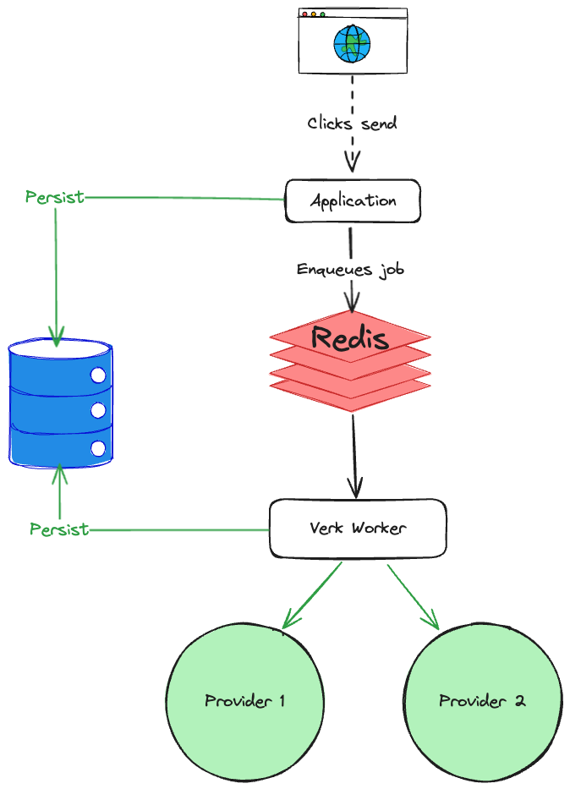
The Old System
Notes:
Let’s look at the old system to understand why we needed to build something new.
GetThru's codebase dates back to 2016. The backend has been Elixir from the start. Elixir started in 2012, but didn't release 1.0 until 2014. This means we probably have one of the oldest continually worked on Elixir codebases in existence. And like any system under development for a long time, core parts of the infrastructure have become creakier. People come and go. Institutional knowledge is lost. The domain changes.
Our existing system for sending messages relies on a Redis backed job processing library in the Elixir ecosystem called Verk. Unfortunately, Verk is now unmaintained and lacks good observability. One option would be to fork Verk and maintain it ourselves. We talked about doing that. But Verk has other issues as well. The biggest one was that it has no built in way to rate limit messages the way we need.
Finally, our current system shoved all the logic to send a message into one Verk worker. We loaded all the data and checked all the rate limits in one job. If a message was rate limited, it was difficult to know which rate limit had been hit. When we attempted to send the message again, we did all the work over. We loaded all the data from the DB again and checked all the rate limits again.

Slide 6
Providers
Notes:
To better understand what finally pushed the old system to its breaking point, we first need to go over a little bit of domain terminology.
First, we send text messages and we do that through providers. We don’t talk directly to carriers. Instead, providers are the services we use to send text messages through. Everybody here has probably heard of Twilio, but there are many others out there and we rely on multiple of them.

Slide 7




Carriers (or Mobile Network Operators)
Notes:
Mobile Network Operators are carriers like AT&T, Verizon, T-Mobile, and US Cellular. In the US, those are basically it. There are many virtual network operators in the US, but they all operate on these networks. Most importantly for later, when we send somebody a text message, we need to know who the underlying mobile network operator is.

Slide 8
Application-to-Person (A2P)
Notes:
When you send text messages on your phone to somebody, that is Person-to-Person (P2P) texting. Strictly speaking, what we do at GetThru is called Application-to-Person (A2P) texting. Even though our customers may end up having a conversation with the contact the message was sent to, that is still considered A2P because it was sent through a provder by our service, not somebody's phone directly.

Slide 9
10 Digit Long Codes (10DLC)
(555) 209-8165
Notes:
When sending those A2P messages in the US, we are sending them through a 10DLC (10 Digit Long Code). Basically, the carrier says you can use this 10 digit phone number for A2P text messaging subject to some limits.
Also, if you’re generating test data for your app, use the 555 area code. It’s been set aside. It’s the phone number equivalent of sending test emails to example.com. You should never accidentally text or call a real number

Slide 10

Notes:
And those 10DLC rules are administered by something called The Campaign Registry (TCR). Our old system had issues, but this is what really broke it.
TCR is an attempt at industry self-regulation by carriers to prevent federal regulation on A2P texting. They verify brands and campaigns prior to them being allowed to send A2P messages. It requires brands to submit information about themselves and their campaigns up front to provide traceability about the who and what of a campaign.
For example, if somebody running in a local election wants to send a get out of the vote message to a list of voters in their area, they must have first registered their brand with TCR and a political use case. The quality of the information they submit and their use case will be part of determining if they are approved, and, if approved, what their rate limits are. More about that later.
TCR was announced in 2021 and went into effect in 2022. Our current system has been struggling with it ever since.

Slide 11
Requirements
Lessen load on DB
Separation of concerns (rate limiting and business logic)
Respect all provider rate limits
Respect all TCR rate limits
Intelligent retries
Observability
Batch sending
Scheduled sending
Notes:
In 2023 we decided that continuing to build on the old system was not sustainable. We needed to start fresh.
One of the first things we did was to write an ADR (Architectural Decision Record). That document outlined the issues with the existing system, requirements for the new system, and a proposal for the architecture of the new system.
First, we needed to lessen the load on the DB. The existing system was putting a very heavy load on it. The way that everything had to be checked again on retry, no matter what caused the retry, was really hammering it. Plus, every message was inserted independently. That was a lot of independent writes. We like our monolith and if we want to keep it, we needed to lower the load on the DB.
We wanted a separation of concerns between rate limiting and business logic. The way we had bolted TCR rate limits onto the legacy system interleaved the two. This made it really hard to reason about.
We needed to respect all the TCR and provider rate limits. TCR rate limits had been bolted onto the legacy system and did not work well.
And related to that was intelligent retries. The legacy system made it hard to know why a message was being rate limited. Since everything was checked in just one job, it was not possible to gate how far a message got in the system by the type of rate limit that was being exceeded.
Observability was a must. This is pretty squishy as far as requirements go, but just about anything was going to be an improvement over our current situation. We needed to be able to answer detailed questions about the systems behavior and also be able to change certain aspects of that behavior at run time. We're big fans of OpenTelemetry, but we would have needed to fork Verk to hook in the telemetry we wanted.
One of the driving business use cases was batch sending. Being able to send out a batch of messages without user intervention for each message. For example, a university wants to send out a fundraising message when their campaign opens at 09:00 in the morning. The initial message is the same for everybody in that campaign. There is no need to for somebody to sit there and click a button over and over to send the message. One good thing about TCR is that we don't have to have somebody sit there clicking a button anymore. There used to be a requirement that a person was involved in sending every message.
Related to that is scheduled send. The ability to schedule the messages to go out automatically at a certain time.
And beyond all of that was the opportunity to rebuild a core part of our system from scratch. We had lost institutional knowledge about the old system. There were legitimate business and technical reasons to build a new system, but regaining that institutional knowledge with the current team was appealing as well.

Slide 12
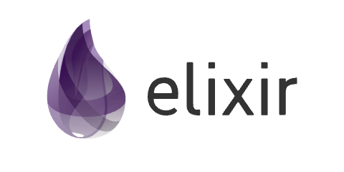

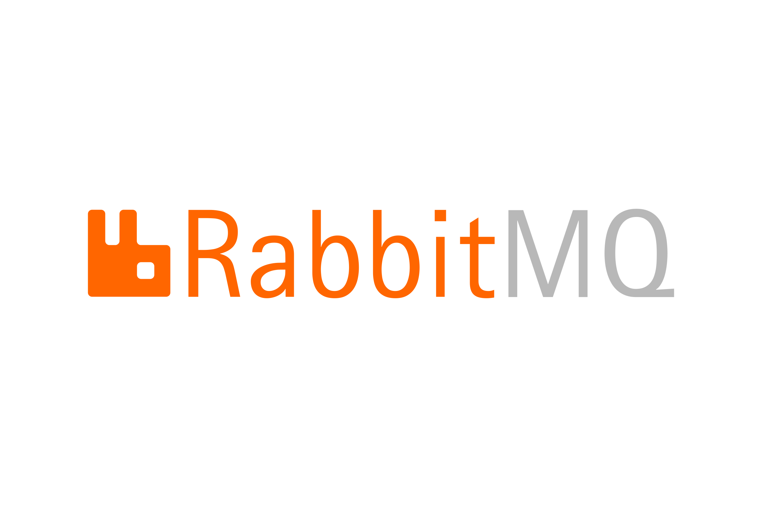


Tech Stack
Notes:
Our tech stack is very… different than most.
As I mentioned earlier, GetThru is a 100% Elixir shop. So, obviously we're going to continue using Elixir here. It's emphasis on concurrency also happens to be really well suited to this problem space. Does anybody else in this room work on an Elixir code base? If you don’t, don’t worry. I am not going to be throwing a bunch of Elixir code at you today.
We had a couple of existing options in our infrastructure for enqueuing jobs. First, we have Oban. Oban is the go-to job processing library in the Elixir ecosystem, having won out over Verk. The problem for us is that it's tied to Postgres. We love Postgres and we're already using Oban. We’re trying to move all of our old jobs from Verk to Oban. But we're also trying to reduce load on our DB. We could have stood up a second DB just for Oban, but that introduces its own complexities. We really like our monolith and limiting the amount of infrastructure we have to maintain.
That led us to Broadway. Broadway is designed for building concurrent and multi-stage data ingestion and data processing pipelines with Elixir. Importantly for us, it has fantastic support for rate limiting.
Broadway supports many different producers, which is what it calls adapters to consume data from a source such as RabbitMQ, Kafka, Amazon SQS and a few others out of the box. We already had RabbitMQ in our existing infrastructure, so that made it an easy choice. For us, it also has the niche advantage of being written in Erlang. Erlang and Elixir run on the same VM, so this helped us feel more comfortable in our ability to debug any issues.
Because we already had Rabbit in our system, we did not seriously evaluate alternatives like Kafka. They're very similar tools. We weren't interested in adding more services to our infrastructure or moving our current Rabbit systems over to anything else.
We also already had Redis in our infrastructure. Redis is a bit controversial in the Elixir ecosystem because the VM gives you so many of the same tools without needing to bring in another dependency. We like it though for our use cases.
Finally, our backend is Elixir and, through the power of Phoenix LiveView, our front end is too. If you’re familiar with Hotwire in the Rails world or Blazor in the C# world, LiveView is the OG version of that architecture style. We write almost no Javascript in our single page application.

Slide 13

Super Collider
Notes:
And all of that comes together into a project we code named Super Collider. And I will say, as someone who has historically rolled his eyes at cute project code names, AI image generation has made them a lot more fun than they used to be.

Slide 14
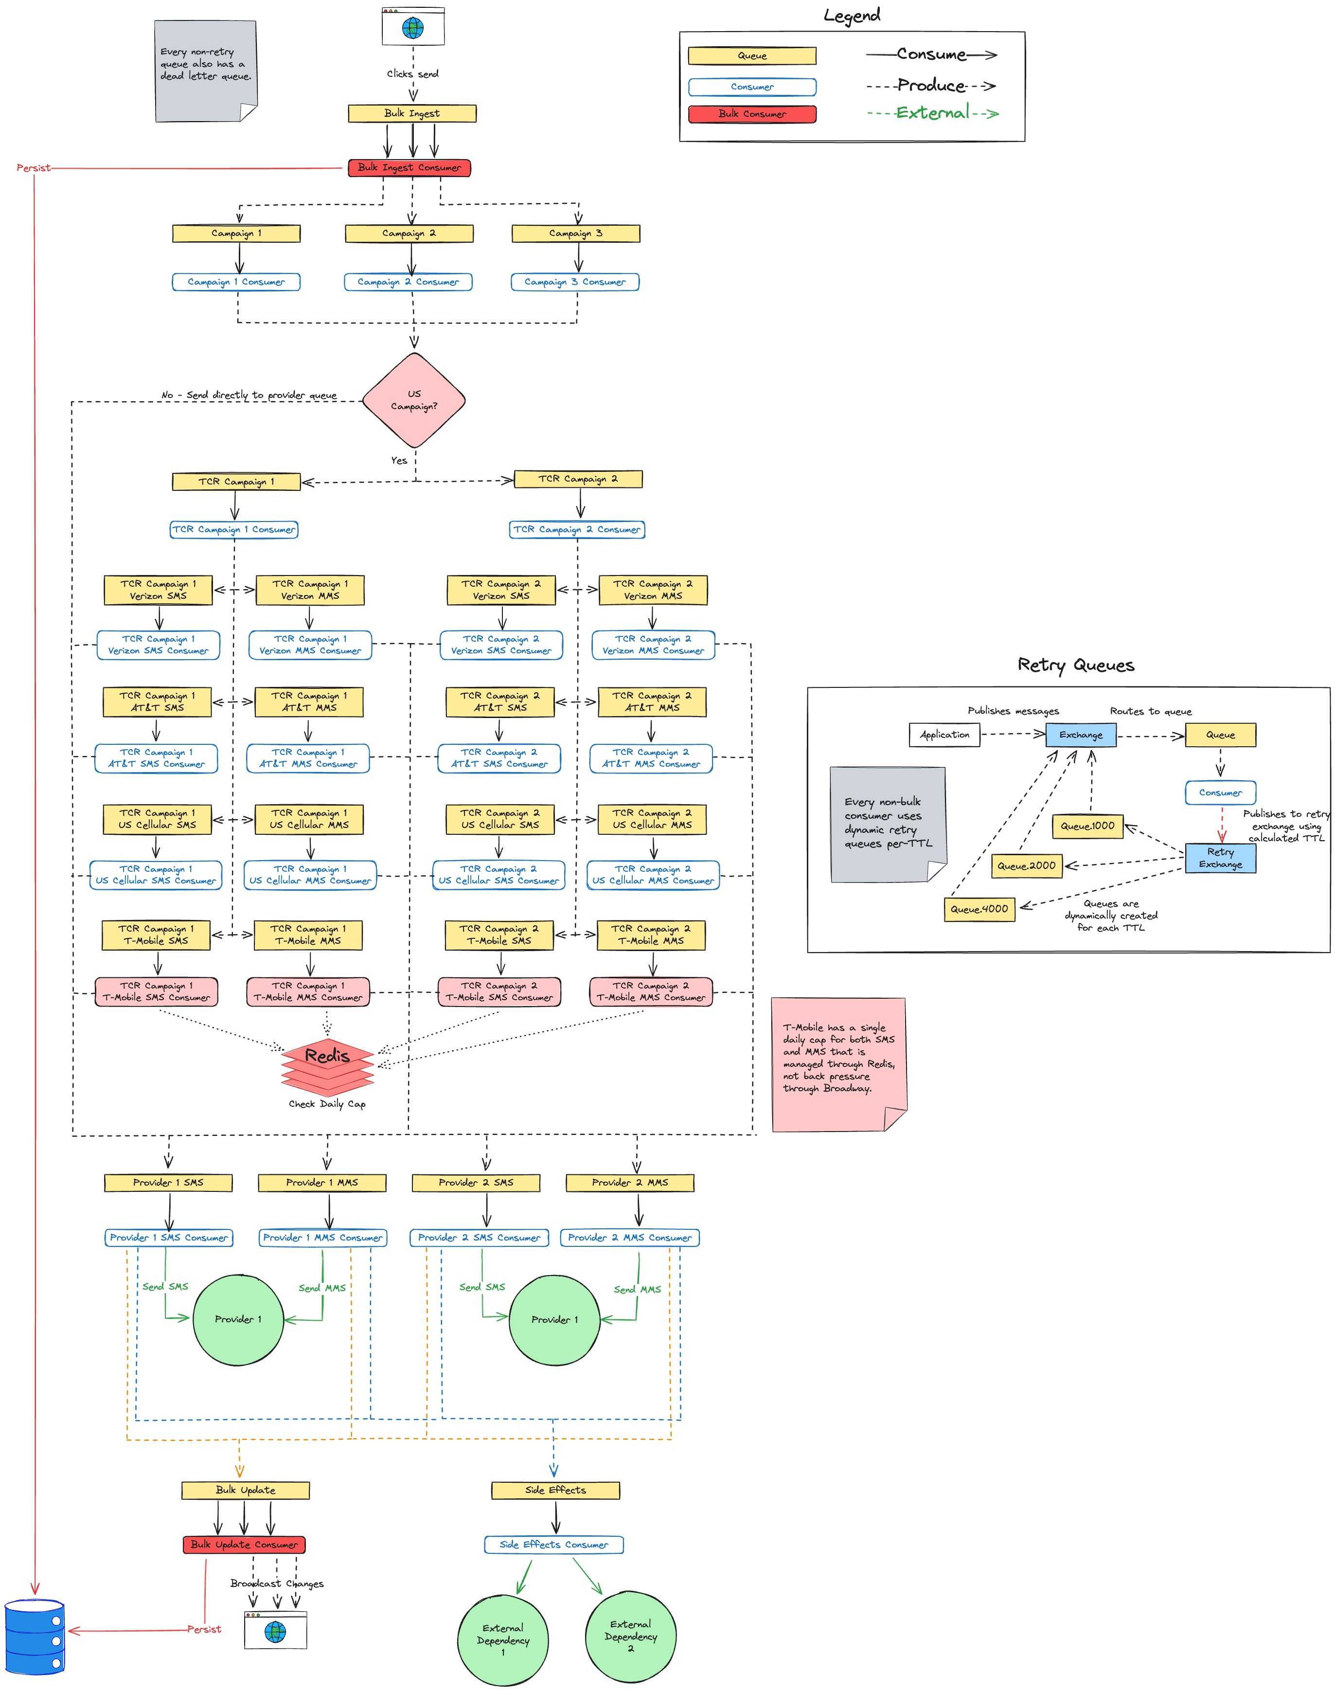
Lessen load on DB
Separation of concerns (rate limiting and business logic)
Respect all provider rate limits
Respect all TCR rate limits
Intelligent retries
Observability
Batch sending
Scheduled sending
Any questions?
Notes:
So, this is it. I think we’ve checked off all the requirements here. Let’s ship it.
Any questions? Does everybody feel like they understand the system just from this diagram? Maybe we should talk through it together to make sure.

Slide 15
Notes:
A huge chunk of that diagram relies on a basic understanding of RabbitMQ concepts, so let’s get started with a very high level overview of terminology around RabbitMQ.

Slide 16
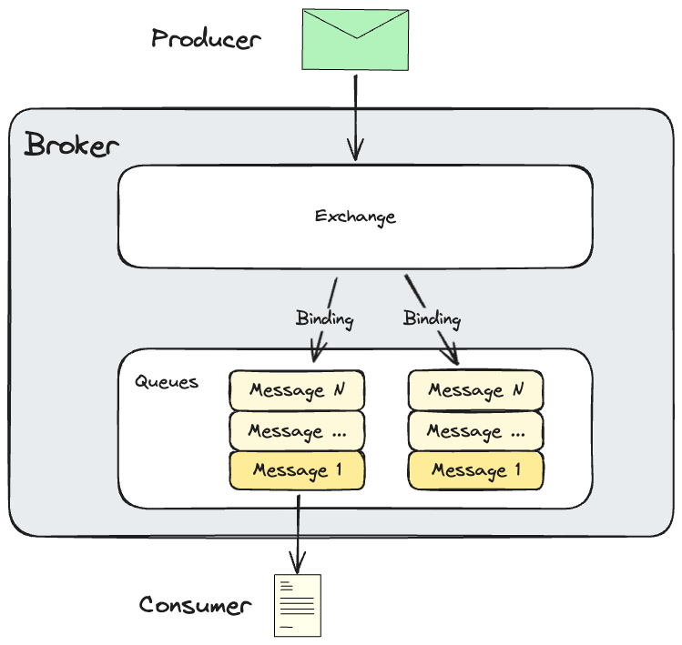
Notes:
This diagram gives a conceptual overview of Rabbit. First, the Rabbit server itself is the broker. A producer is part of your application code that produces messages to send to RabbitMQ. Those messages get sent to an exchange. The exchange is responsible for routing those messages to queues. Importantly, the outside world does not send messages directly to queues. The outside world knows about an exchange, which then routes the messages to a queue.
It knows how to route those messages based on the exchange type and bindings. A binding defines how a given exchange should route incoming messages to queues.
Our message bodies our JSON, but Rabbit is happy to use ProtoBuf, MessagePack, or whatever else your heart desires. Rabbit doesn’t care. For us, we like being able to peek into our queues to see messages during debugging, so we’re sticking with JSON.
Finally, your application creates consumers. Consumers connect to RabbitMQ and consume messages from a queue. Importantly, a consumer can also be a producer. As we'll see, this is the case for most of our consumers.
For the rest of this talk, I’m going to shortcut things by talking about sending messages to queues. Just be aware that is hand waving over a bit more complexity than that. We don’t have any complicated routing rules in our system, so that shouldn’t cause any large headaches.
Rabbit is also very configurable. We leaned into resiliency at the expense of optimal scalability for now, by making our queues persistent to disk and highly available across nodes in our Rabbit cluster. In our use case, losing messages is not acceptable. In your use case that may not be true. Rabbit can be configured for either.
This talk is meant to be a case study of a system using RabbitMQ, not a deep dive into Rabbit itself, so let’s move on to the pipeline.

Slide 17
Bulk Ingest Stage
Notes:
Our pipeline starts when a user clicks a button to send a message. We want to make sure that messages gets into our database up front. Our legacy system did this too, but it did it immediately for every single message. The user clicked the button to send the message and we immediately persisted that message to our DB. Only after that did we enqueue a Verk job. One of our goals in the new system was to lessen the load on the DB. This was a prime opportunity to do that.

Slide 18
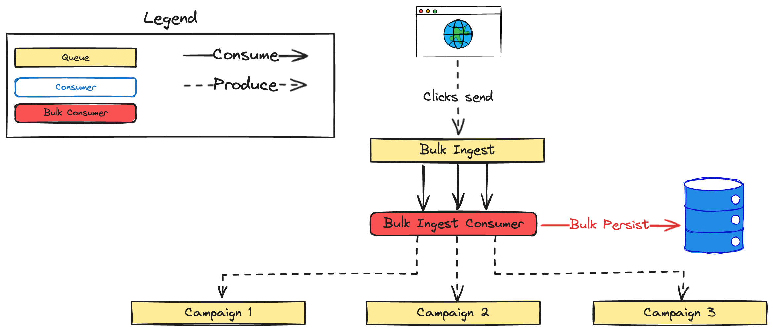
Notes:
Hence, bulk ingest. Instead of persisting each message individually, we’re going to persist them in batches with bulk insert operations. This will lessen the number of roundtrips to the DB. The raw number of records getting inserted is the same, but we’re batching together into more efficient transactions.
In this diagram we can see that a user clicks the button to send a message. This enqueues a message in our bulk ingest queue. From there we have configured a Broadway consumer to consume messages from the queue in batches. The consumer then processes all the messages in that batch at once and bulk persists the DB changes in as few roundtrips as possible. This includes persisting the new message, updating the status of the conversation that message is part of, and some other miscellaneous pieces of bookkeeping for business rules.
After all of that data is persisted, each message is sent along to the queue for the correct campaign. We’ll go over what a campaign is soon.

Slide 19

Batch Sizes
Notes:
Broadway allows us to configure both the size of the batch and the timeout. If not enough messages come in to fill the entire batch before the batch timeout, Broadway will send a smaller batch to the consumer. For example, if batch size is 50 with a timeout of 100ms, then if there are only 25 messages after 100ms, those 25 messages will be sent to the consumer as a single batch.
Getting the proper batch size has been more art than science so far. We’re going to continue to refine this more.

Slide 20

Lesson Learned
Pipeline Message Struct
Notes:
One mistake we made in our initial implementation was to tie our message payload structure to our DB schema. This had a couple of issues.
First, it tightly coupled our messages to our DB schema. Any change to our DB schema risked changing the shape of messages in our pipeline. This was brittle and made versioning of the messages difficult.
Second, it increased the size of our payload. We were passing around a bunch of data that is important in our schema, but not important for sending messages.
Luckily, we were able to fix this. Making this kind of fix is way easier before going live. It would have been way harder to make this change after going live. We would have needed to support both message structures for some period of time until all the old messages had flowed out of the system.
Proper versioning of changes to our pipeline message struct is still something we have to manage, but being able to make those changes independently of our DB schema is huge.
Bulk ingest is the point where the transformation happens. Messages are built using our DB schema and then sent to bulk ingest. Bulk ingest persists these to the DB and then transforms them into a pipeline message for all subsequent stages in the pipeline.

Slide 21
Requirements
Lessen load on DB (partially)
Separation of concerns (rate limiting and business logic)
Respect all provider rate limits
Respect all TCR rate limits
Intelligent retries
Observability
Batch sending
Scheduled sending
Notes:
This partially checks off our first requirement. We’ll see at the end of the pipeline that we do some similar batching for updates after the message was sent out. I’m going to go ahead and cross it off here though even though we’ve only done it partially.
I’m not going to check this one off yet, but this also gets a long ways towards batch sending. Currently, all of our messages come from a user clicking a button, but that doesn’t have to be the case. Some other event in the system could easily queue up thousands of messages. Our bulk ingest stage is setup to support that without stressing the DB too much.
This is a big point for doing as little work up front when the user clicks the button to send a message. By pushing persisting the data into the bulk ingest stage of the pipeline, we make it easier to add other ways of sending messages in the future.

Slide 22
Campaign Stage
Notes:
Let's move on to the next stage in our pipeline. Our customers send messages as part of what we call "campaigns" in our domain. A user creates a campaign and adds a list of contacts to it. When a campaign is launched, we attach a phone number from one of our providers to it that will be used to send the message. All messages for a single campaign will be sent through one provider.
It looks roughly like this

Slide 23
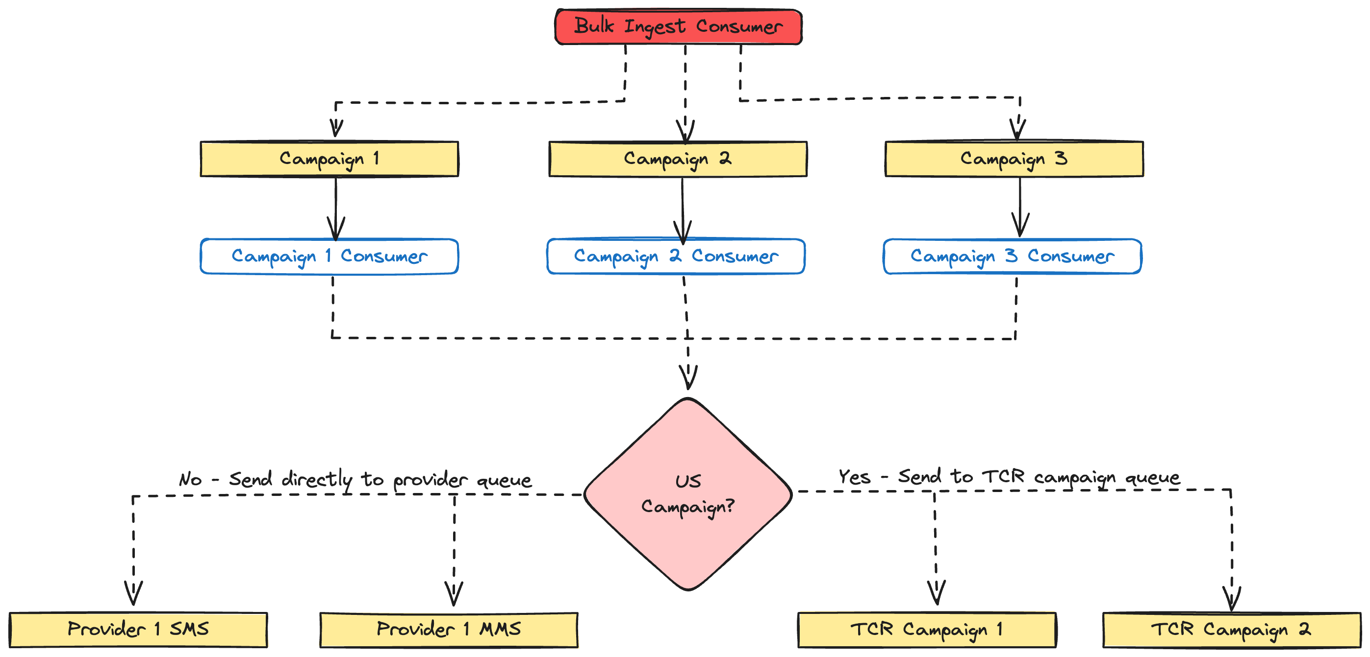
Notes:
We saw the top of this diagram before. The bulk ingest consumer has a batch of messages. Once it has persisted information about the text messages to send out to our DB, it produces new messages that will be routed to the appropriate queue for the GetThru campaign. Note that the bulk ingest consumer is also a producer. That is common throughout our pipeline. Each consumer consumes messages from Rabbit and then produces a new message to send to the next stage in the pipeline.
Each campaign gets its own queue and consumer. When a campaign is launched, we dynamically create a queue in RabbitMQ for that campaign.
In addition to the GetThru campaign queue, we’re also going to dynamically start a Broadway consumer process. That process will then start consuming messages from the corresponding GetThru campaign queue.
Most of our pipeline stages are very simple. The campaign stage exists purely to check if the campaign is in the US, and, if so, that the TCR campaign is properly configured. If the campaign is not in the US, then it is not subject to TCR and we can send messages directly to our provider queues so we can send a text message. If the campaign is in the US though and we confirm that it is properly configured, then we send it to the correct TCR campaign queue.
Our customers can have multiple GetThru campaigns at one time, but often times those campaigns are going to share the same TCR campaign. For example, both campaigns 2 and 3 could be subject to TCR and both use TCR Campaign 2.

Slide 24
Send Message Stage
Notes:
Let’s go down the simple path for non-US campaigns first. These aren’t subject to TCR, so we can push messages directly to our Send Message Stage. This is where we make an API to one of our providers to send a text message.

Slide 25
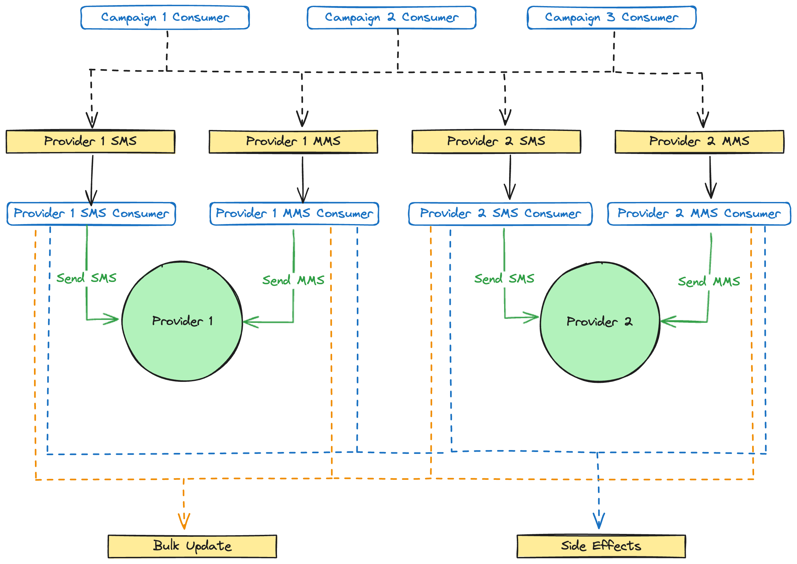
Notes:
All of these campaigns are non-US, so the consumers publish their messages directly to the provider queue for the campaign. There are separate queues for both SMS and MMS messages for each provider. This is because each provider has a separate rate limit for how many SMS and MMS messages you can send in a window. For example, a provider may allow you to send 500 SMS messages per minute, but only 250 MMS messages per minute.
Assuming a consumer can successfully send an SMS or MMS to the provider, we then publish two Rabbit messages. One will go to a bulk update queue and the other will go to a side effects queue. You can see that the orange lines go from each consumer to the bulk update queue and the blue lines from each consumer to the side effects queue.
Importantly, just because a provider has accepted our API request to send an SMS or MMS does not guarantee it’s going to be delivered to somebody’s phone. There are a lot of things that could go wrong, but we don’t get immediate feedback on that. We have to wait for them to call a webhook in our system with information on message deliverability.
Now, I mentioned provider rate limits. Each provider limits how many SMS and MMS messages we can send in a window. Remember that one of requirements was to have a clean separation of concerns between rate limiting and business logic, and the way we do that is through back-pressure

Slide 26
Broadway & Back Pressure
Notes:
Back-pressure is the concept of a consumer telling a producer or source of events how many it wants at a time. Rabbit has no concept of rate limiting or back-pressure. Instead, we configure it in Broadway. Let's walk through some examples.

Slide 27
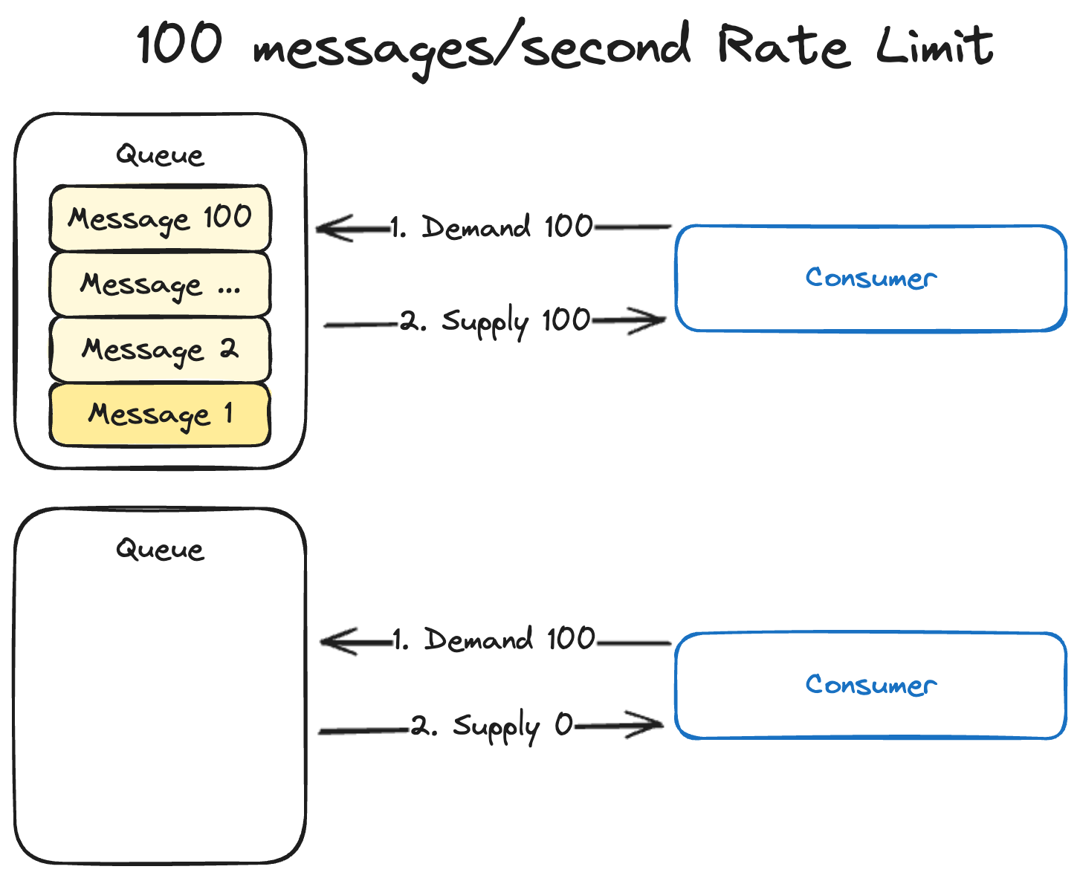
Notes:
Let's say our provider is rate limiting us to 100 SMS messages/second. We have a consumer that is going to make the API call to the provider to actually send the SMS. We configure that consumer to demand 100 messages/second from a Rabbit queue. In this case we can see that we demand 100 messages. The queue conveniently has exactly 100 of them, so it supplies 100.
One second later the consumer will demand another 100, but now the queue is empty so 0 get supplied.

Slide 28
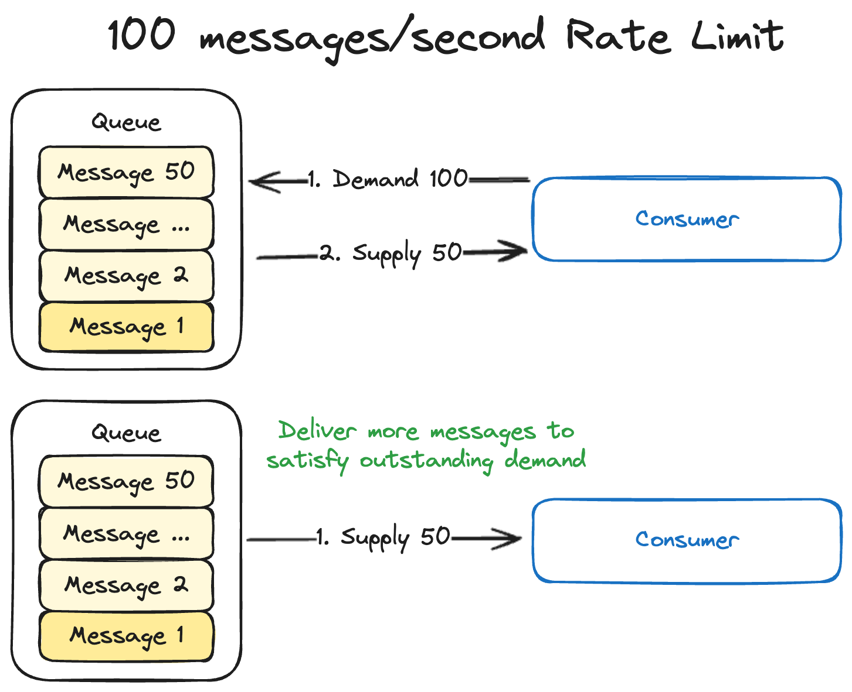
Notes:
But what if there aren't enough messages in the queue to satisfy the demand to begin with. In this case we demand 100, but the queue only has 50. Those get supplied to the consumer.
But what if another 50 messages get added to the queue before the rate limit window expires? Rabbit will push those 50 messages to the consumer to satisfy the demand.

Slide 29
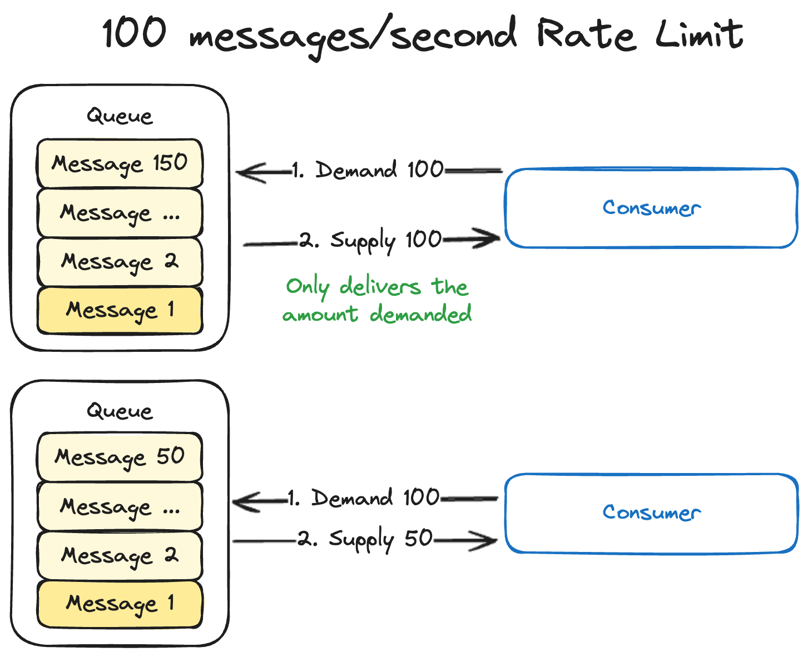
Notes:
And finally, what if there are too many messages in the queue. In this example, the queue has 150 messages, but our rate limit is still 100/second. The consumer demands 100 and is immediately supplied with 100. The consumer processes all of those and then demands another 100 in the next second. There are only 50 to supply this time, which puts us in the same situation as the last example.
These examples all show one consumer with one processor, but you can configure Broadway to use multiple processors per consumer as well. Maybe you have so many messages coming in that one processor can't keep up. This kind of concurrency is Elixir's bread and butter and Broadway makes it simple.
There is a lot more you can do with Broadway, but this is a reasonable enough simplified explanation of back-pressure for our purposes.
Our consumers are all configured to use one processor with a rate limit equal to the provider’s rate limit for that message type. If our provider has a rate limit of 250 MMS/second and we configure our rate limit in Broadway to the same, then back-pressure ensures that we will never exceed our provider rate limit.
Messages may pile up in the Rabbit queue, but that is a different problem. Attempting to process more messages isn't going to solve the problem of the provider rate limit being too low in that case.

Slide 30
Requirements
Lessen load on DB (partially)
Separation of concerns (rate limiting and business logic)
Respect all provider rate limits
Respect all TCR rate limits
Intelligent retries
Observability
Batch sending
Scheduled sending
Notes:
This checks off another one of our requirements, separation of concerns. We rate limit API calls to our providers purely through configuration. When the consumer processes messages from the queue it can focus purely on business logic.

Slide 31
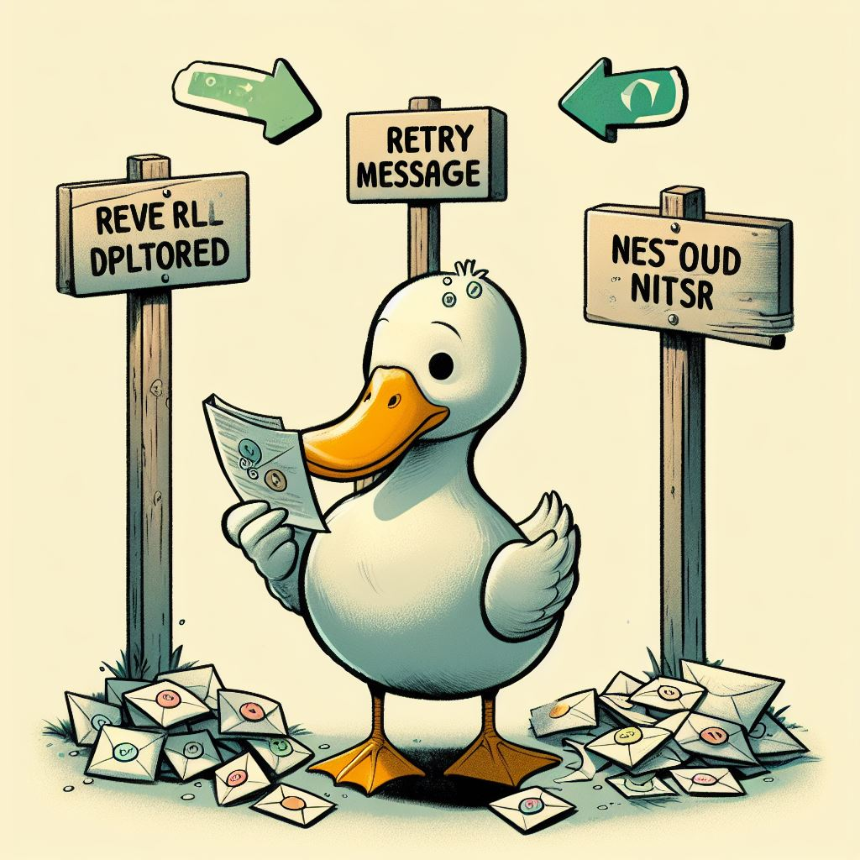
Retry Strategy
Notes:
That doesn't mean things can't still go wrong though. We still need to be able to retry messages. The provider may be down. There could be bugs in our code. Depending on the scenario, we may want to retry.
A good retry strategy is trickier than you would think in RabbitMQ. We based our strategy on an article by Brian Storti.
There are three simple ways to handle failures in Rabbit: discard the message, requeue it, or send it to a dead-letter exchange. Discarding messages is not acceptable in our scenario. That would mean our client's text message is never sent.

Slide 32
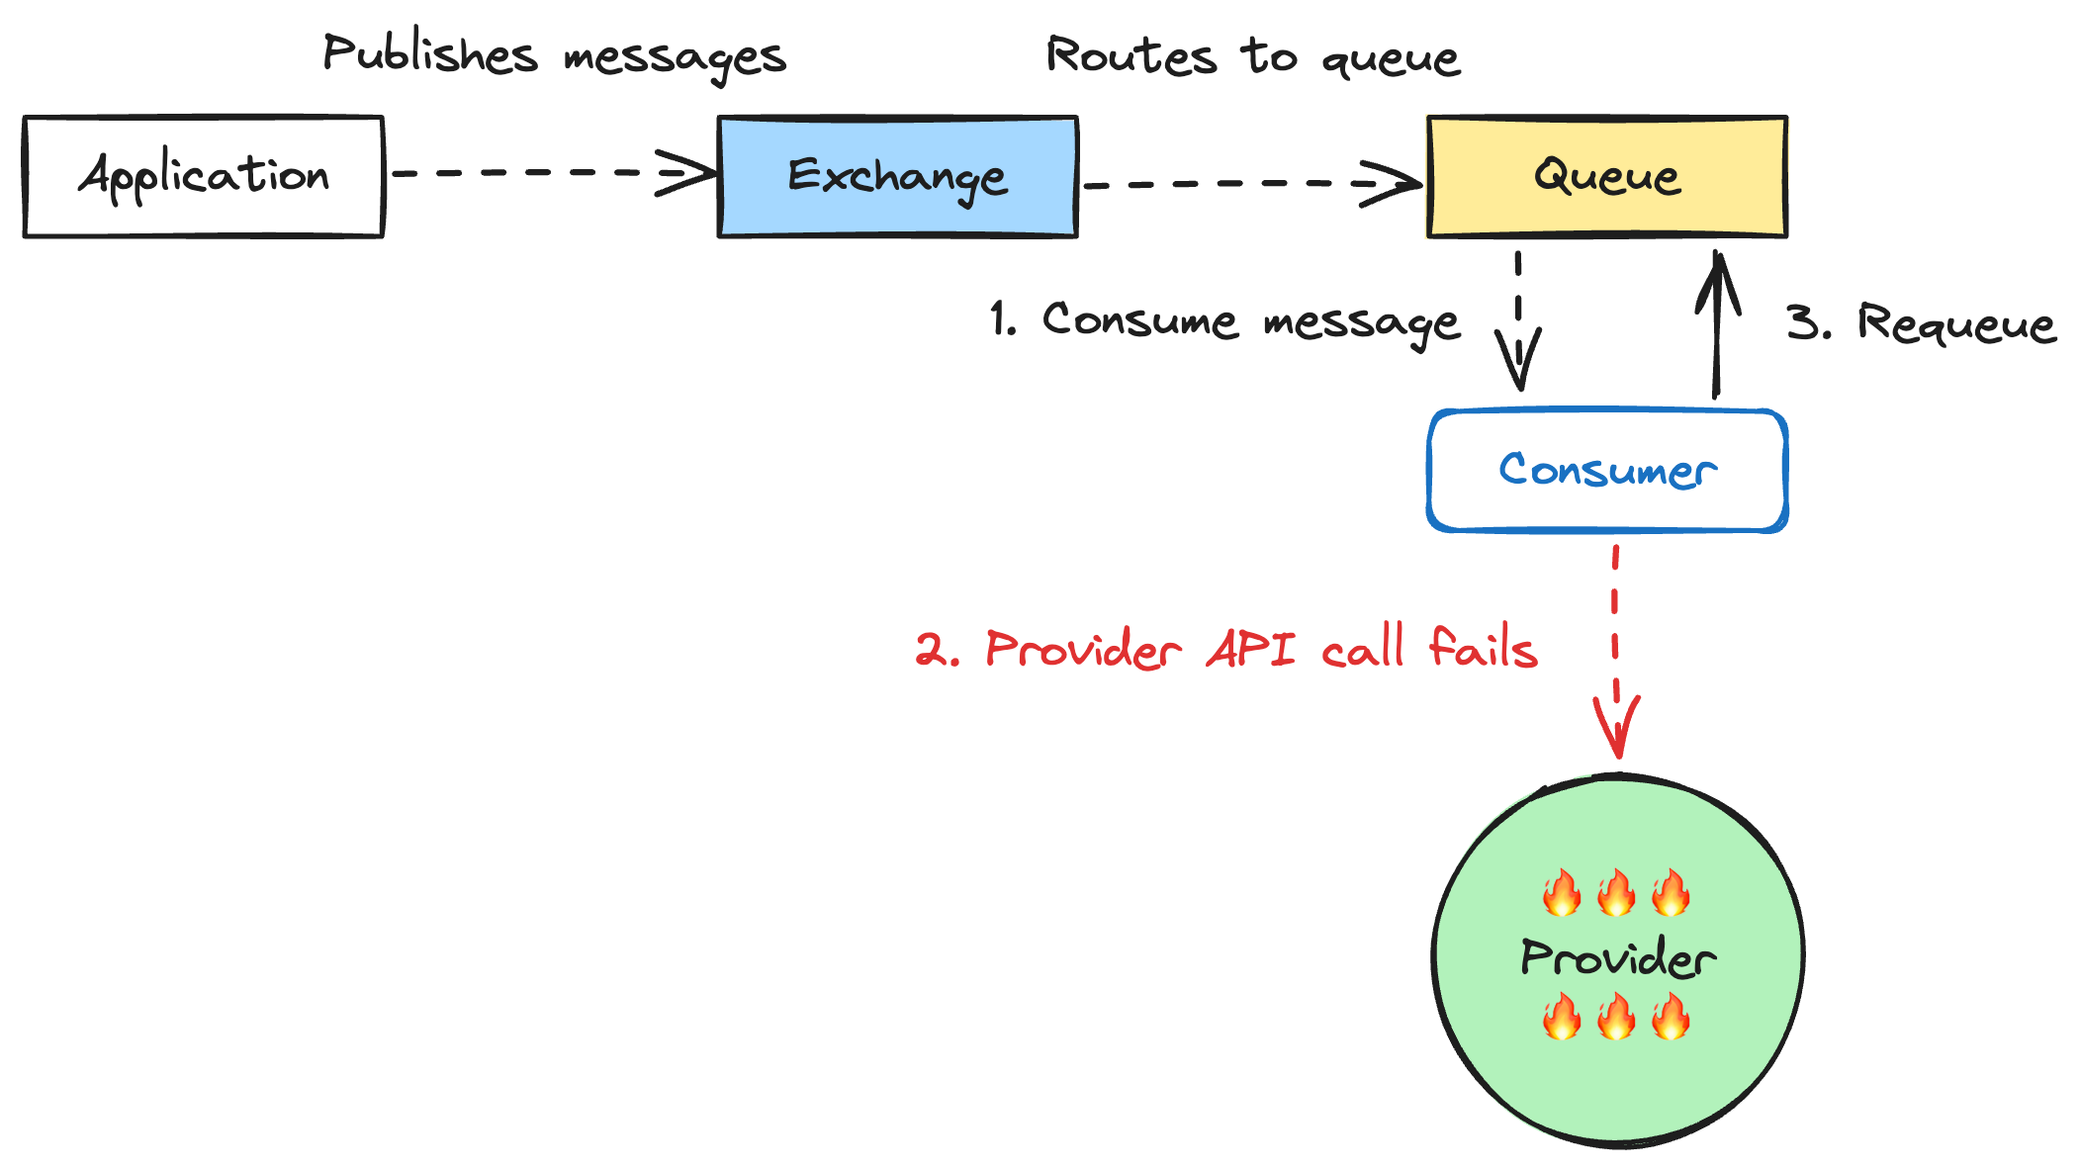
Notes:
Requeuing is also a non-starter. If our provider is down, then just requeuing the message will just send it again as soon as it comes back to the front of the queue. We're just going to spam the provider even though their system is down. So, that one is out too.

Slide 33
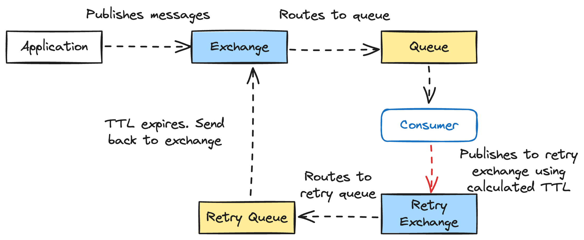
Notes:
That leaves us with dead-lettering. Initially, that seems promising. It's is a nice fallback, but requires knowing what to do with those failed messages. It you have one corresponding dead-letter queue for each queue in your system, then it can be difficult to automatically recover. You end up having to manually shovel messages from your dead-letter queue back to the working queue.
But what if we setup a retry exchange with a per-message time-to-live (TTL) and a DLX of the worker queue? When the message fails, we'll increment the number of times that particular message has failed to calculate the exponential backoff. Then we set that backoff as the TTL of the message in the retry queue. When the first message in a retry queue reaches it's TTL, it will be moved back to the worker queue for retry.

Slide 34
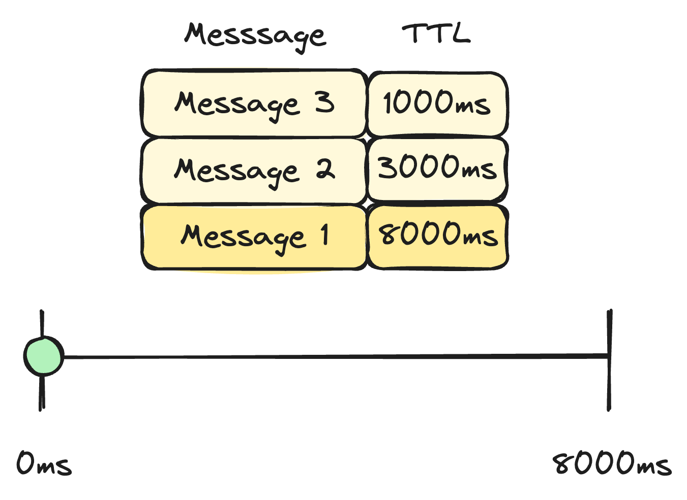
Notes:
This sounds great, but has a fatal flaw. Rabbit won't expire messages until they reach the front of the queue. Let’s look at an example. Here we have a retry queue that contains three messages. The first message in the queue has a TTL of 8000ms, the next one a TTL of 3000ms, and the last one a TTL of 1000.

Slide 35
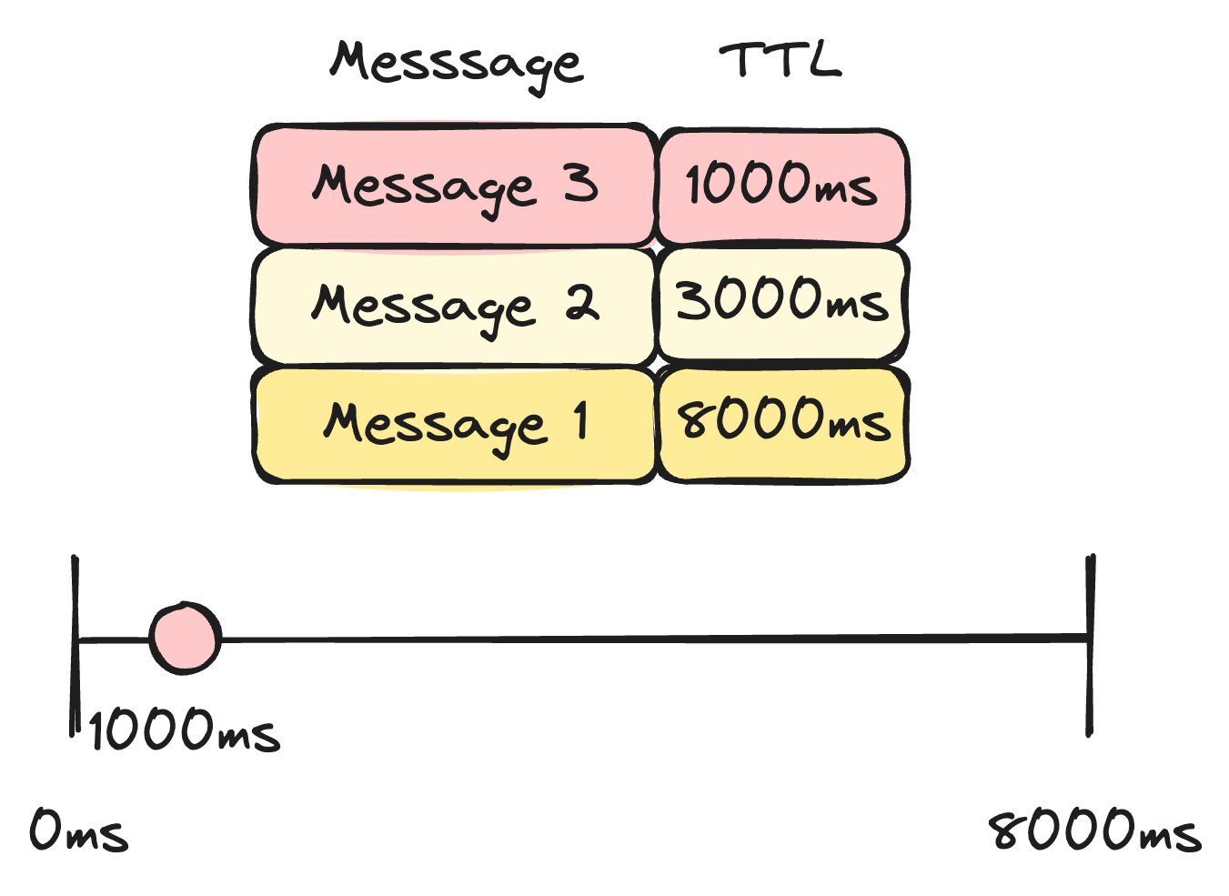
Notes:
At 1000ms the last message in the queue is at it’s TTL, but Rabbit can’t expire it yet. It’s not at the front of the queue and the front messge won’t expire until 8000ms have passed.

Slide 36
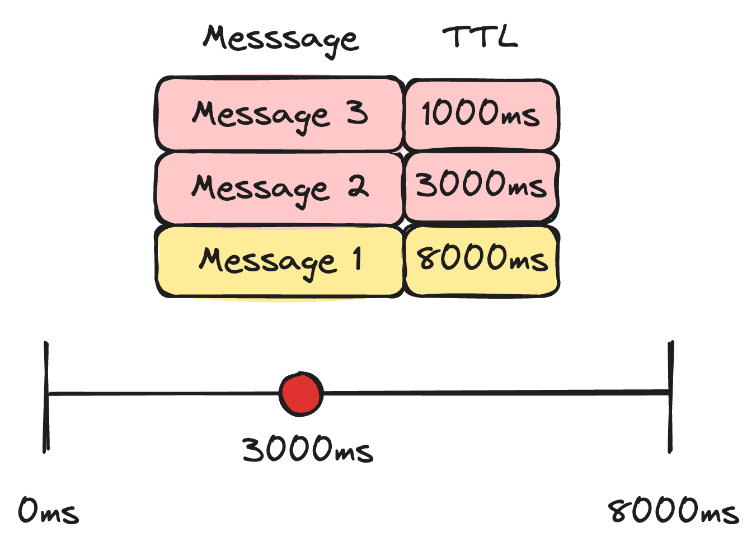
Notes:
At 3000ms the middle message in our queue expires, but it’s stuck too.

Slide 37
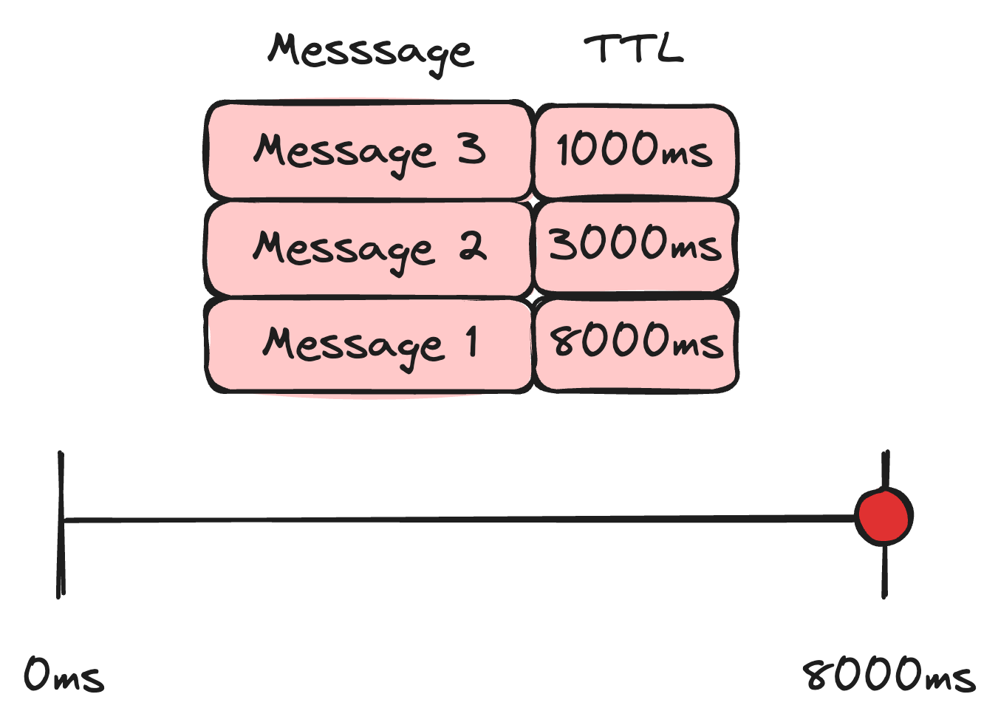
Notes:
Finally, at 8000ms the message at the front of the queue expires. This message will be sent back to the exchange. Then message 2 will come to the front. It’s already expired so it moves out right away. Same for the last message after that.
Every message in our queue effectively had a TTL of 8000ms because that was the TTL of the first message and it was the longest.

Slide 38
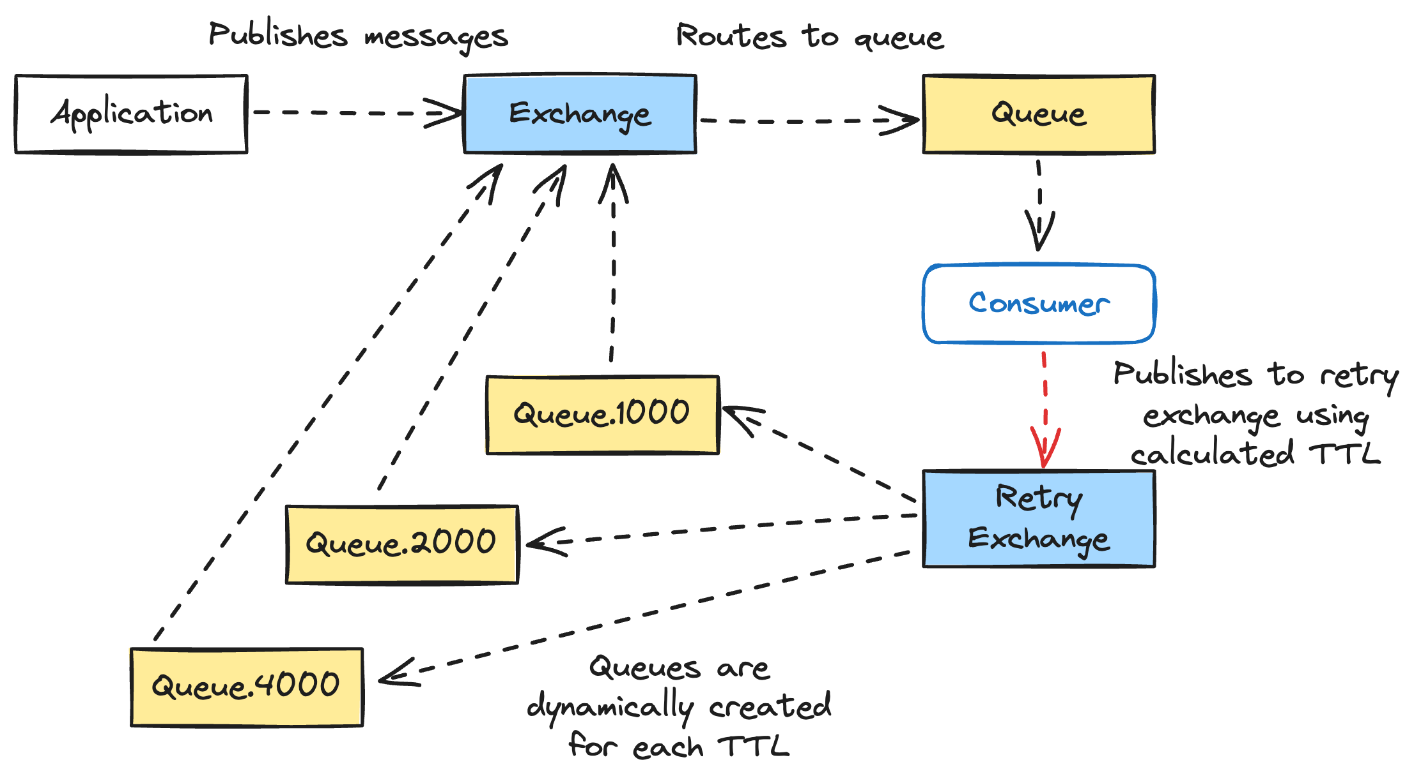
Notes:
The way to work around this is to setup retry queues per TTL. All messages on their first retry get sent to queue.1000. All messages on their second retry get send to the queue.2000, and so on. If every message in the queue has the same TTL, then they will expire in order. No messages will have a shorter TTL and get blocked by one in front.
Does anybody see a downside here with this? Has anybody implemented exponential backoff before? What is important to include in an exponential backoff algorithm? Yes, jitter. Jitter adds some randomness to your backoff to smear the retries across time to avoid a thundering herd. Because the TTL for each retry must end up in a queue for that retry amount, we lose the ability to add jitter to our backoff calculation. That is unfortunate, but a tradeoff we felt was worthwhile for what this gives us.

Slide 39
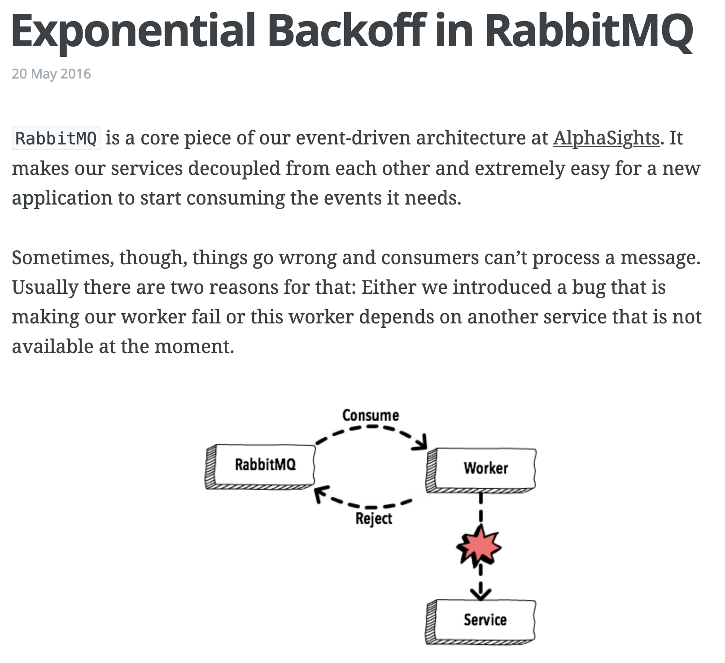

https://www.brianstorti.com/rabbitmq-exponential-backoff
Notes:
This is one of the most important things you can take away from this talk. If you're building an event or message-driven system with a lot of retries, then read this article. There is a good chance that's it's going spur a lot of excellent discussion about your architecture and domain. Even if this solution doesn't work for you, you're going to end up in a better place for having read it.

Slide 40

Lesson Learned
Retries Are Hard
Notes:
This retry queue setup solved a lot of problems for us, but it didn't come without complications. Besides the limitation of no jitter on our backoff, there is also a lot of dynamic queue creation going on.
This will become obvious as we continue to build up the pipeline for our domain, but we're going to end up with a lot of queues in this system. Almost all of these support retries. That means the potential for a lot of retry queues.
We still need to figure out over time how many retries makes sense for various stages in the pipeline and what the backoff should be. That’s going to take iteration over time in production

Slide 41
Requirements
Lessen load on DB (partially)
Separation of concerns (rate limiting and business logic)
Respect all provider rate limits
Respect all TCR rate limits
Intelligent retries
Observability
Batch sending
Scheduled sending
Notes:
This checks off two more requirements, respecting all provider rate limits and intelligent retries

Slide 42
Bulk Update Stage
Notes:
Now we’ve made an API call to a provider to send a text message, but we still need to update our DB to reflect that the message has been sent.
Bulk ingest helped with write performance when ingesting messages into our system. Creating a pipeline message struct specifically for passing through the pipeline helped with read performance as messages went through the pipeline. There was still one big win we wanted though. We wanted to bulk update messages at the end of the pipeline after the message was sent through a provider.

Slide 43
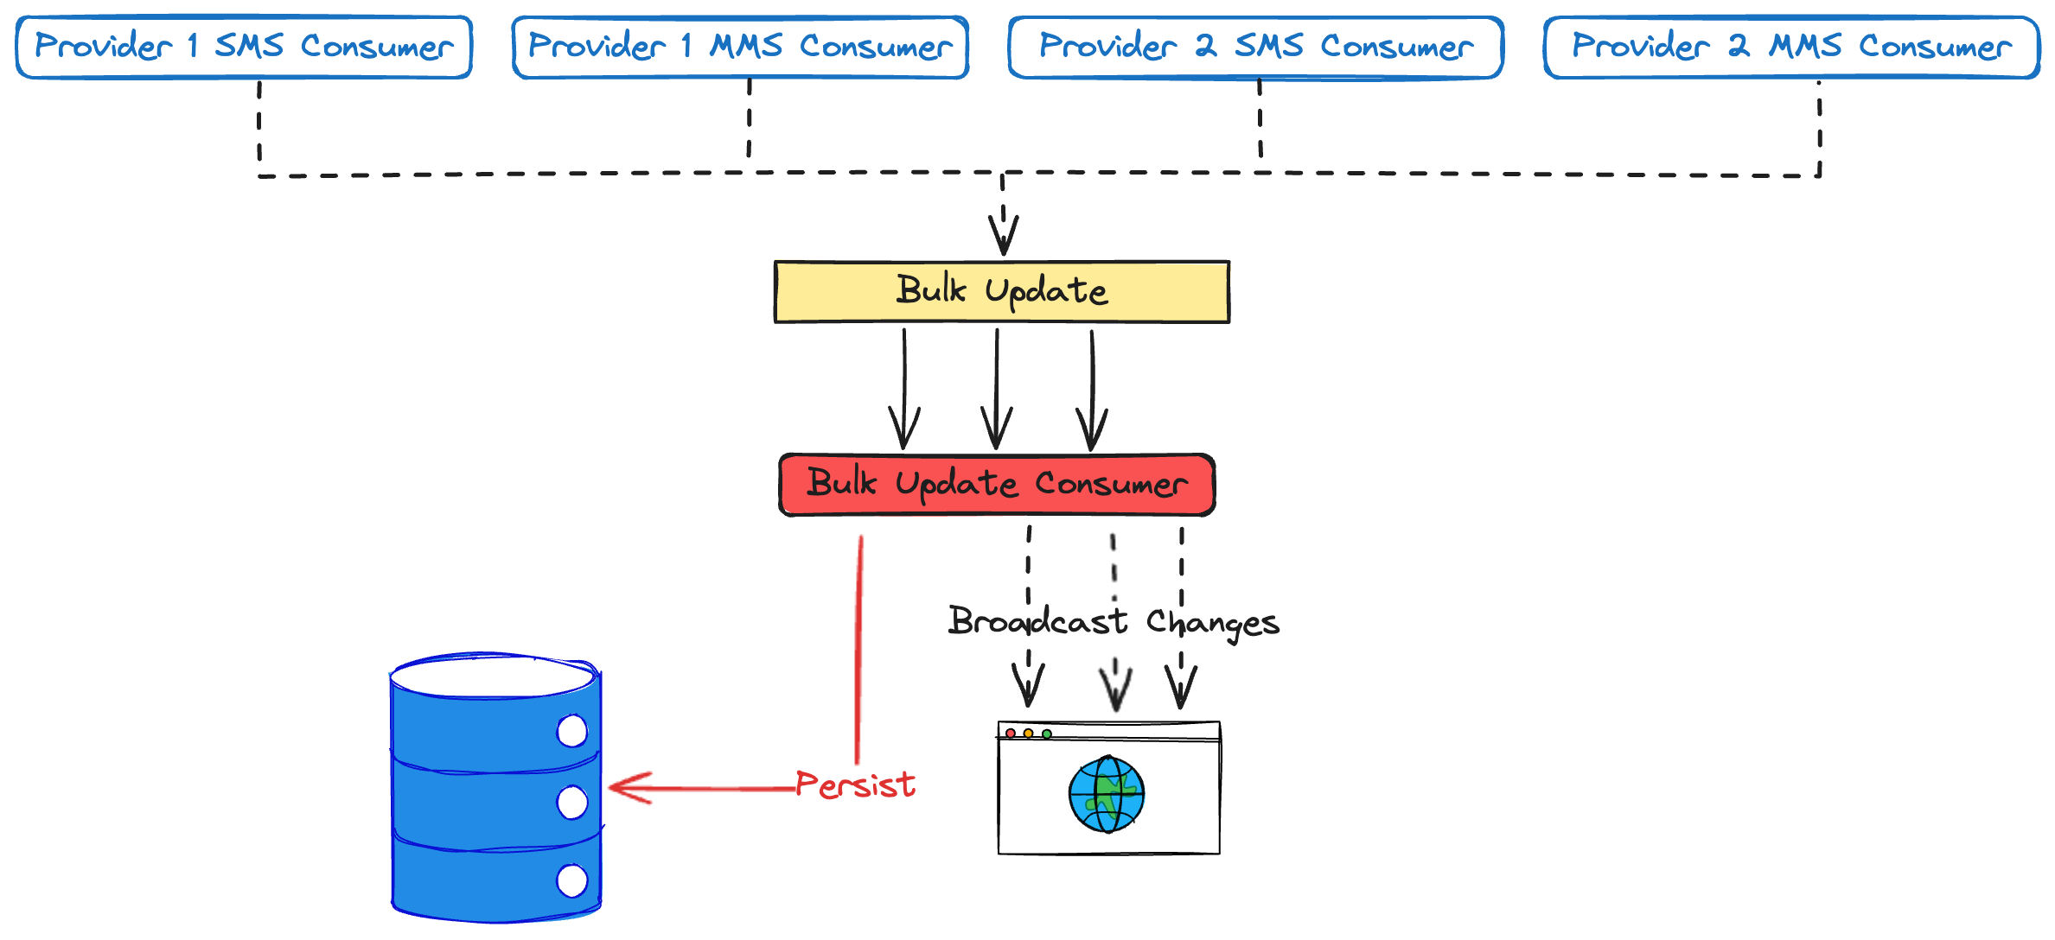
Notes:
To do that, we added a bulk update stage. It uses the same kind of batching we do for bulk ingest. There are a couple of wrinkles here though.
First, we need to update the DB whether we sent the text message or not. In some circumstances we need to update the message status to failed. Sometimes a message is never going to send. Maybe it's been too long. Maybe the client closed their campaign while the message was going through the pipeline. We need to persist those messages as failed.
Second, we need to broadcast that this message has been sent and its status updated in the DB. Maybe the UI needs to update in some way. Maybe some other system cares. In many other ecosystems, this would be another job for the message broker. That’s not necessary in Elixir. Elixir systems are made up of tiny processes that are actors. And in the actor model, actors send messages to each other. Using the Phoenix’s PubSub support, we can easily publish messages that other actors in the system can subscribe to. No extra message bus needed.
And this works across network boundaries. One node in our cluster could be processing messages in its bulk update consumer. An actor on another node can be notified transparently of this. And we get all of this pretty much for free because of the VM Elixir runs on, the BEAM.

Slide 44

Magic
Notes:
Getting this kind of power with such little effort feels like magic. Elixir often feels like forbidden alchemy.

Slide 45
Requirements
Lessen load on DB
Separation of concerns (rate limiting and business logic)
Respect all provider rate limits
Respect all TCR rate limits
Intelligent retries
Observability
Batch sending
Scheduled sending
Notes:
Earlier, we partially checked off lessening the load on the DB. The combination of bulk insert, bulk update, the pipeline message struct, and smart use of caches throughout stages should really lighten the load on our DB. I'm comfortable getting rid of the partially note on that requirement now.

Slide 46
Side Effects Stage
Notes:
Like most systems, there are side effects we want to happen when a message is sent. The PubSub in bulk update is certainly a side effect, but I’m talking about external side effects. For example, our clients might us to update a 3rd party system that they contacted a voter.
To accommodate this, we add one more stage to our pipeline. Details depend on the nature of the integration, but the general idea is outlined here

Slide 47
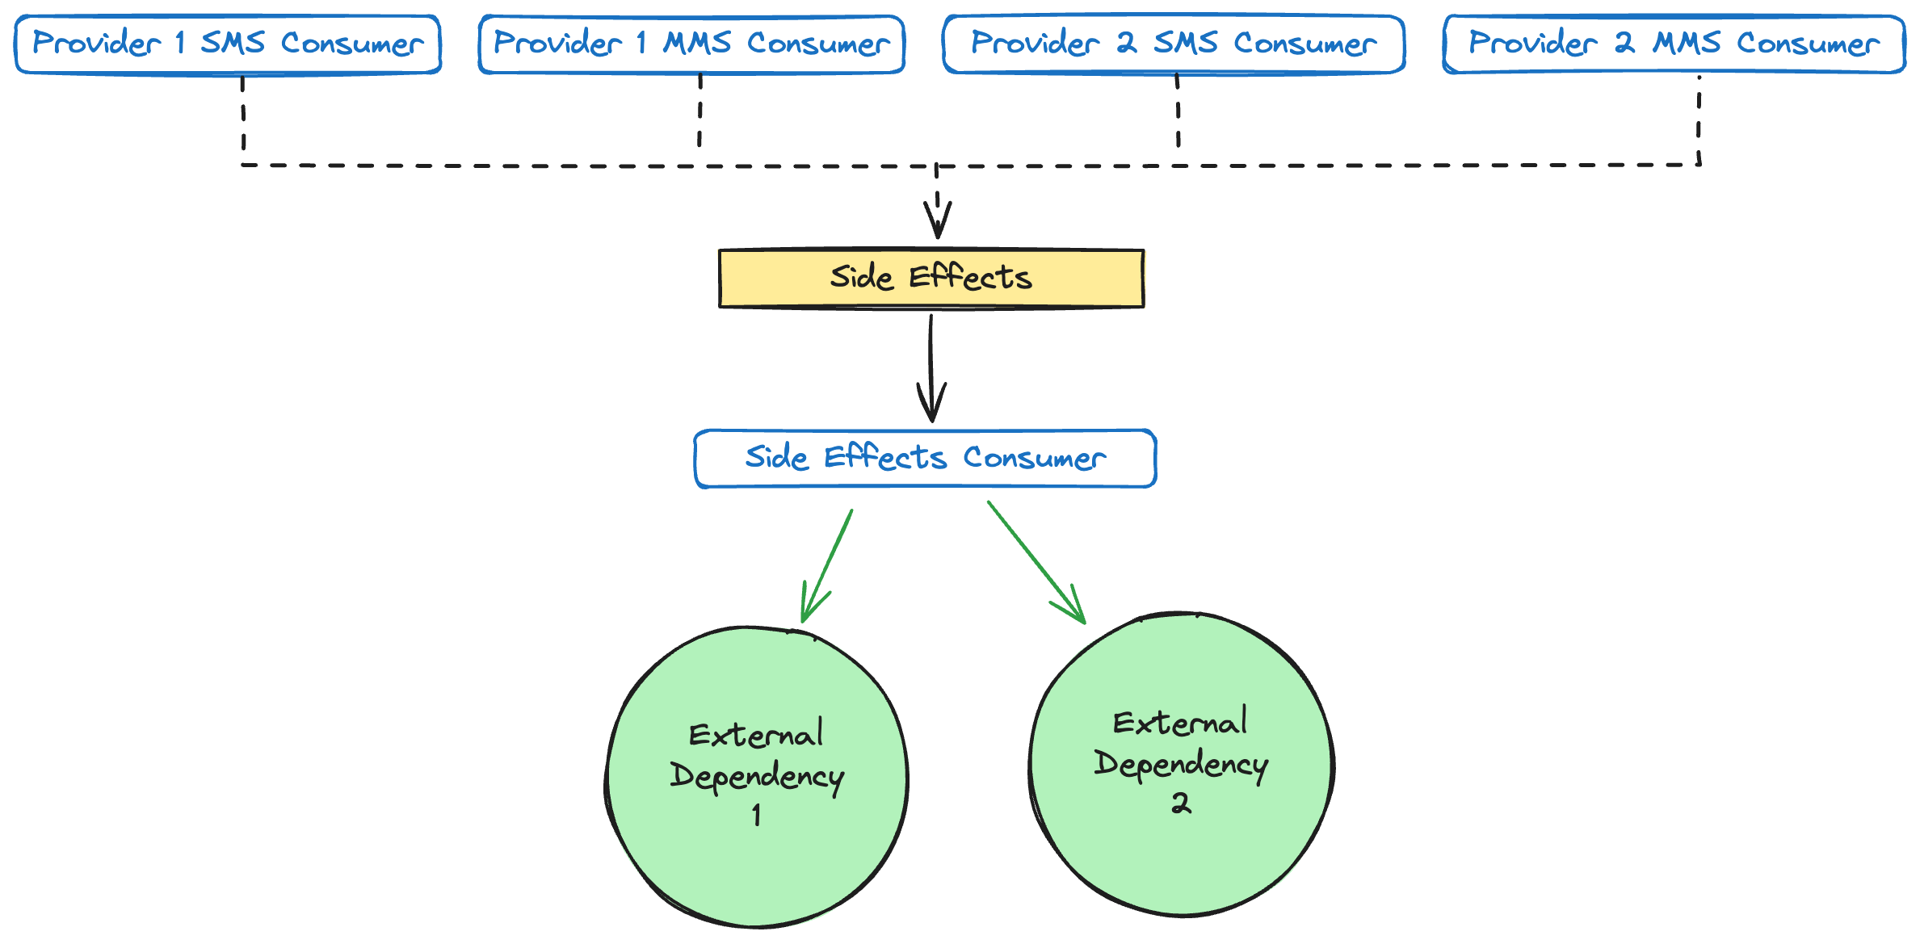
Notes:
The provider consumer now publishes two messages. It publishes to the bulk update queue as before, but now it also publishes to an outgoing side effects queue for the integration. Messages are consumed from side effects queue by a side effects consumer and processed.
Right now we have one queue and one consumer for all side effects, but we would like to split this into separate queues for each 3rd party integration. This will isolate failures when 3rd parties have issues and let us rate limit when necessary through back pressure per 3rd party integration.

Slide 48
😰
Notes:
That does it for our non-US customers. We see that their GetThru campaign is outside the US, send the text message through a provider while respecting their rate limits, update our DB and handle side effects.
But what about this big middle part of the diagram? This is where The Campaign Registry and carrier rate limits live.
Don’t let anybody tell you that you can’t use the tacky animations in Powerpoint. We have been given great power and what fun is it if you don’t abuse it on occasion.

Slide 49
Carrier Rate Limit Stage
Notes:
Remember that TCR is the carrier industry’s attempt at self-regulation of A2P text messaging. They want to allow A2P text messages (and profit from them) for various use cases, but keep them from being so annoying that the federal government steps in with regulation.
In practice, what this means is that we register a TCR campaign on behalf of our customers. TCR takes all the information about the campaign and spits back a vetting score. This vetting score determines how many SMS and MMS messages can be sent in a given interval.

Slide 50
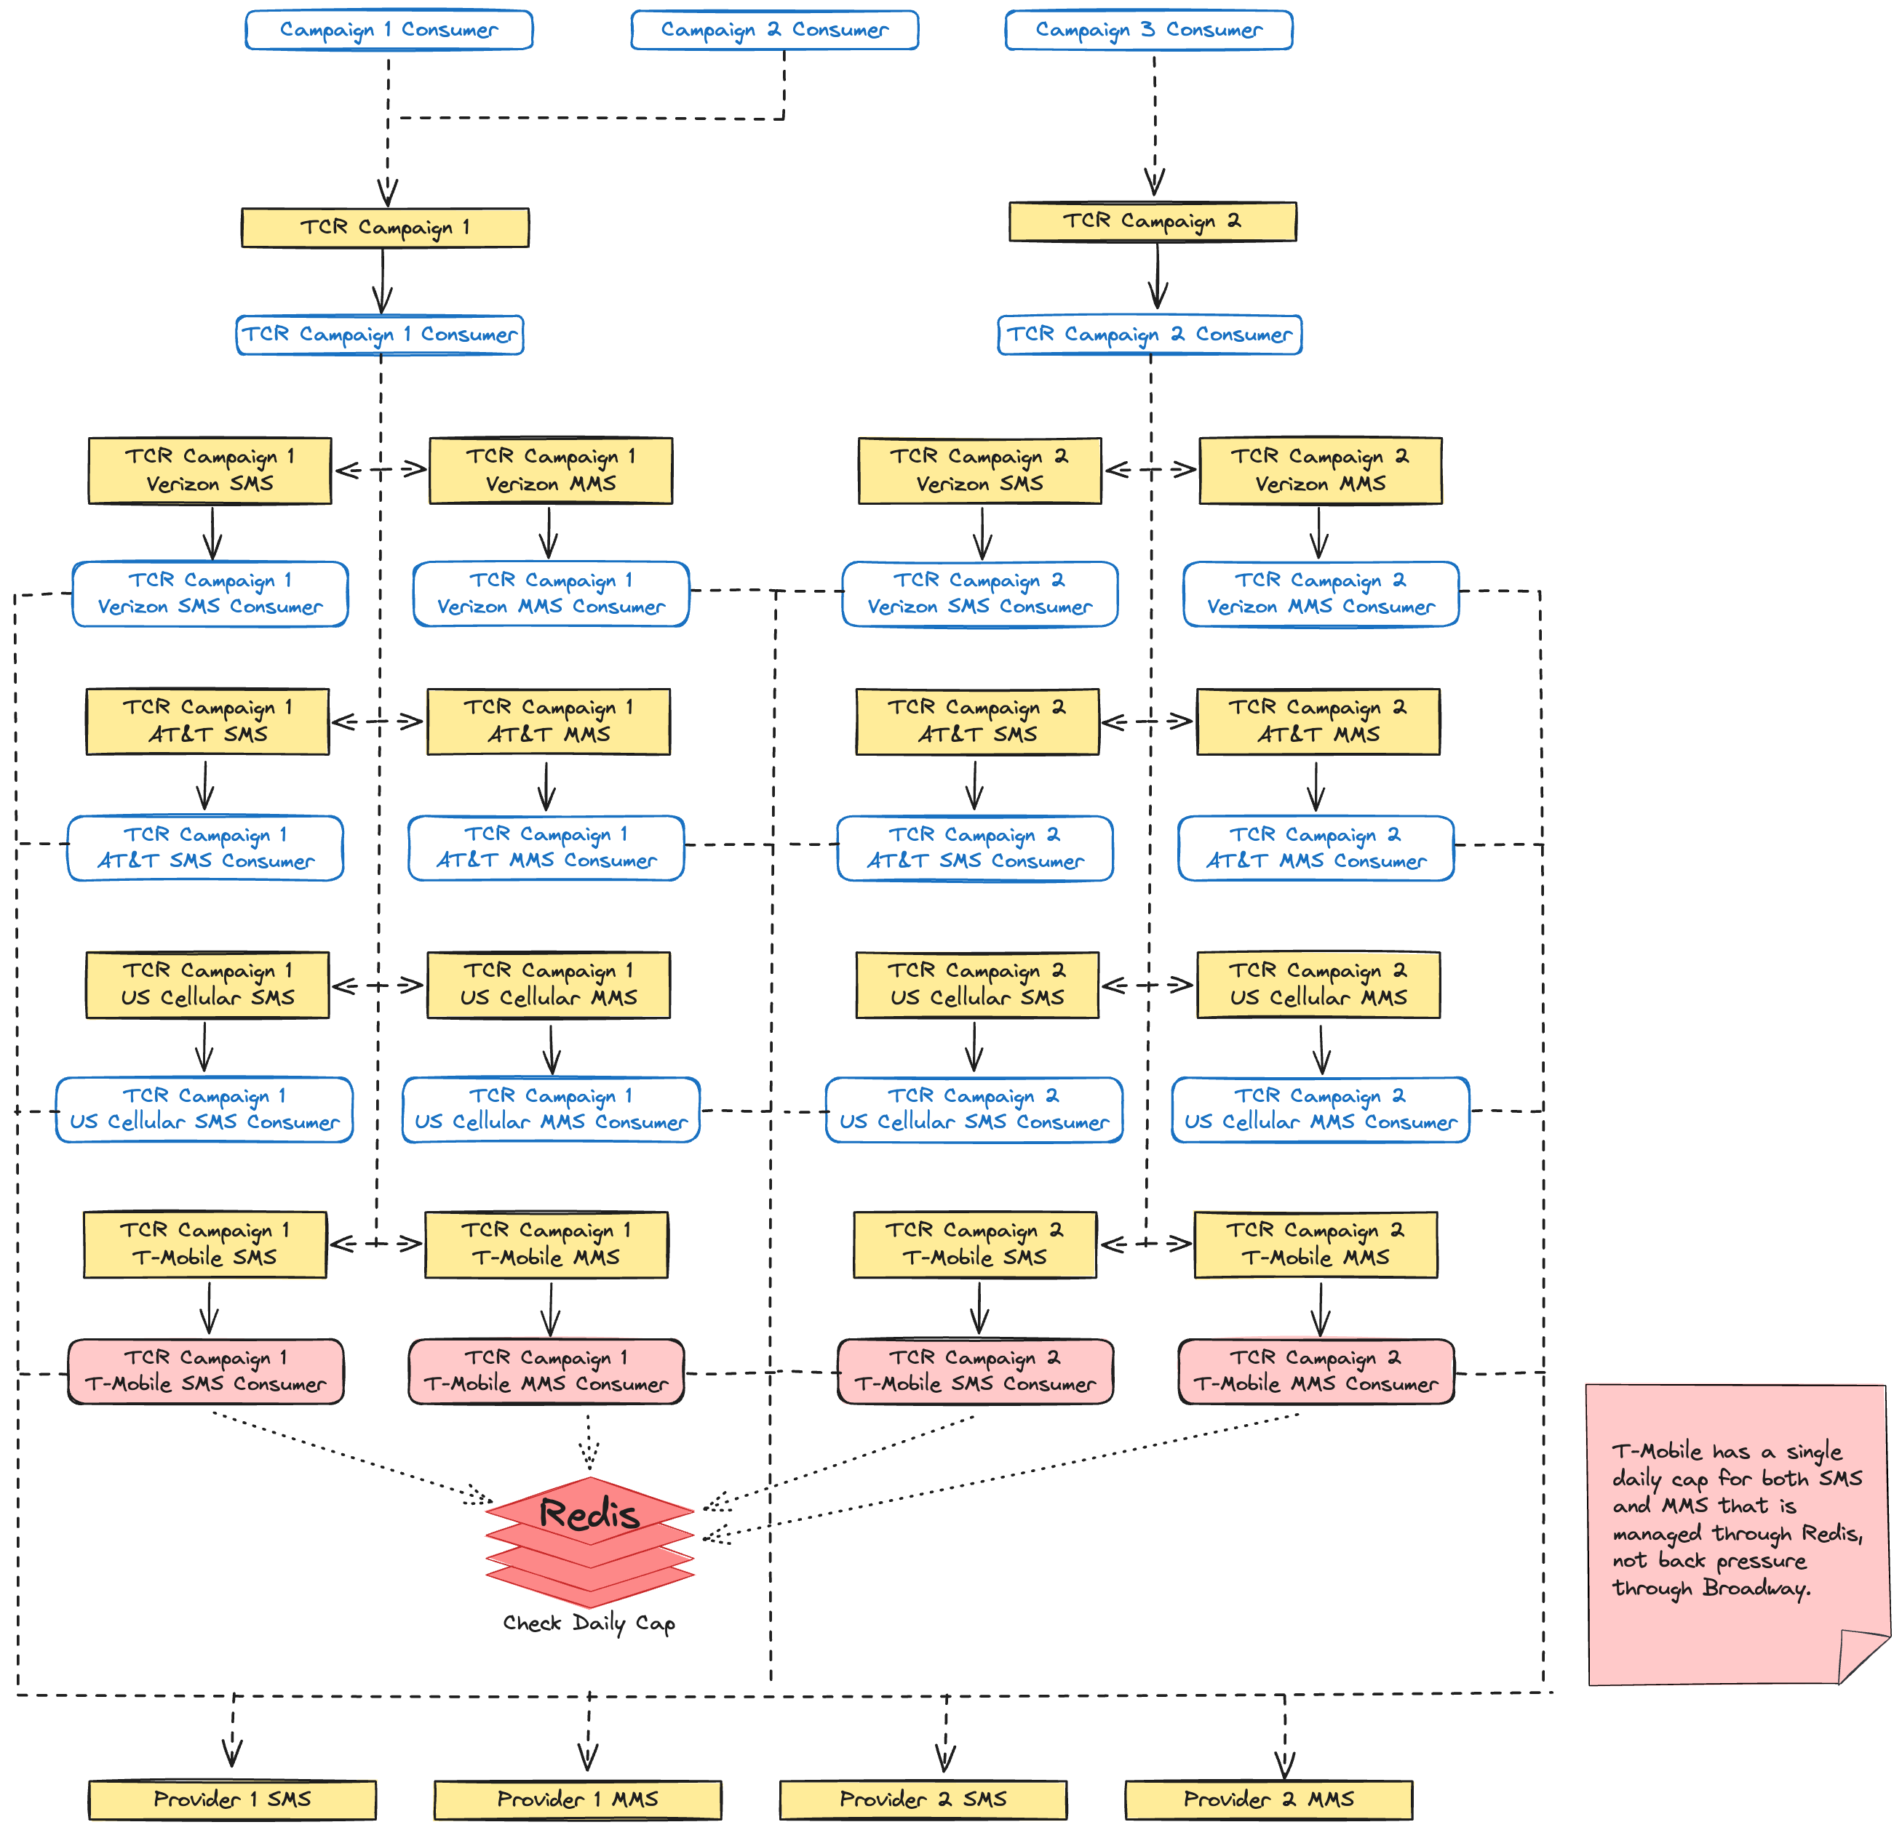
Notes:
And that brings up back to this scary looking part of our diagram. Starting at the top with our campaign consumers, let’s assume this campaign is in the US. That means it is subject to TCR, so we send a message to the TCR campaign for that GetThru campaign. Importantly, this is not a 1-to-1 relationship. There could be multiple GetThru campaigns for one TCR campaign. TCR has given us rate limits per carrier, so next the messages gets sent to the appropriate carrier queue for that TCR campaign.
This is still too much though, so let’s look at how it works for just AT&T

Slide 51
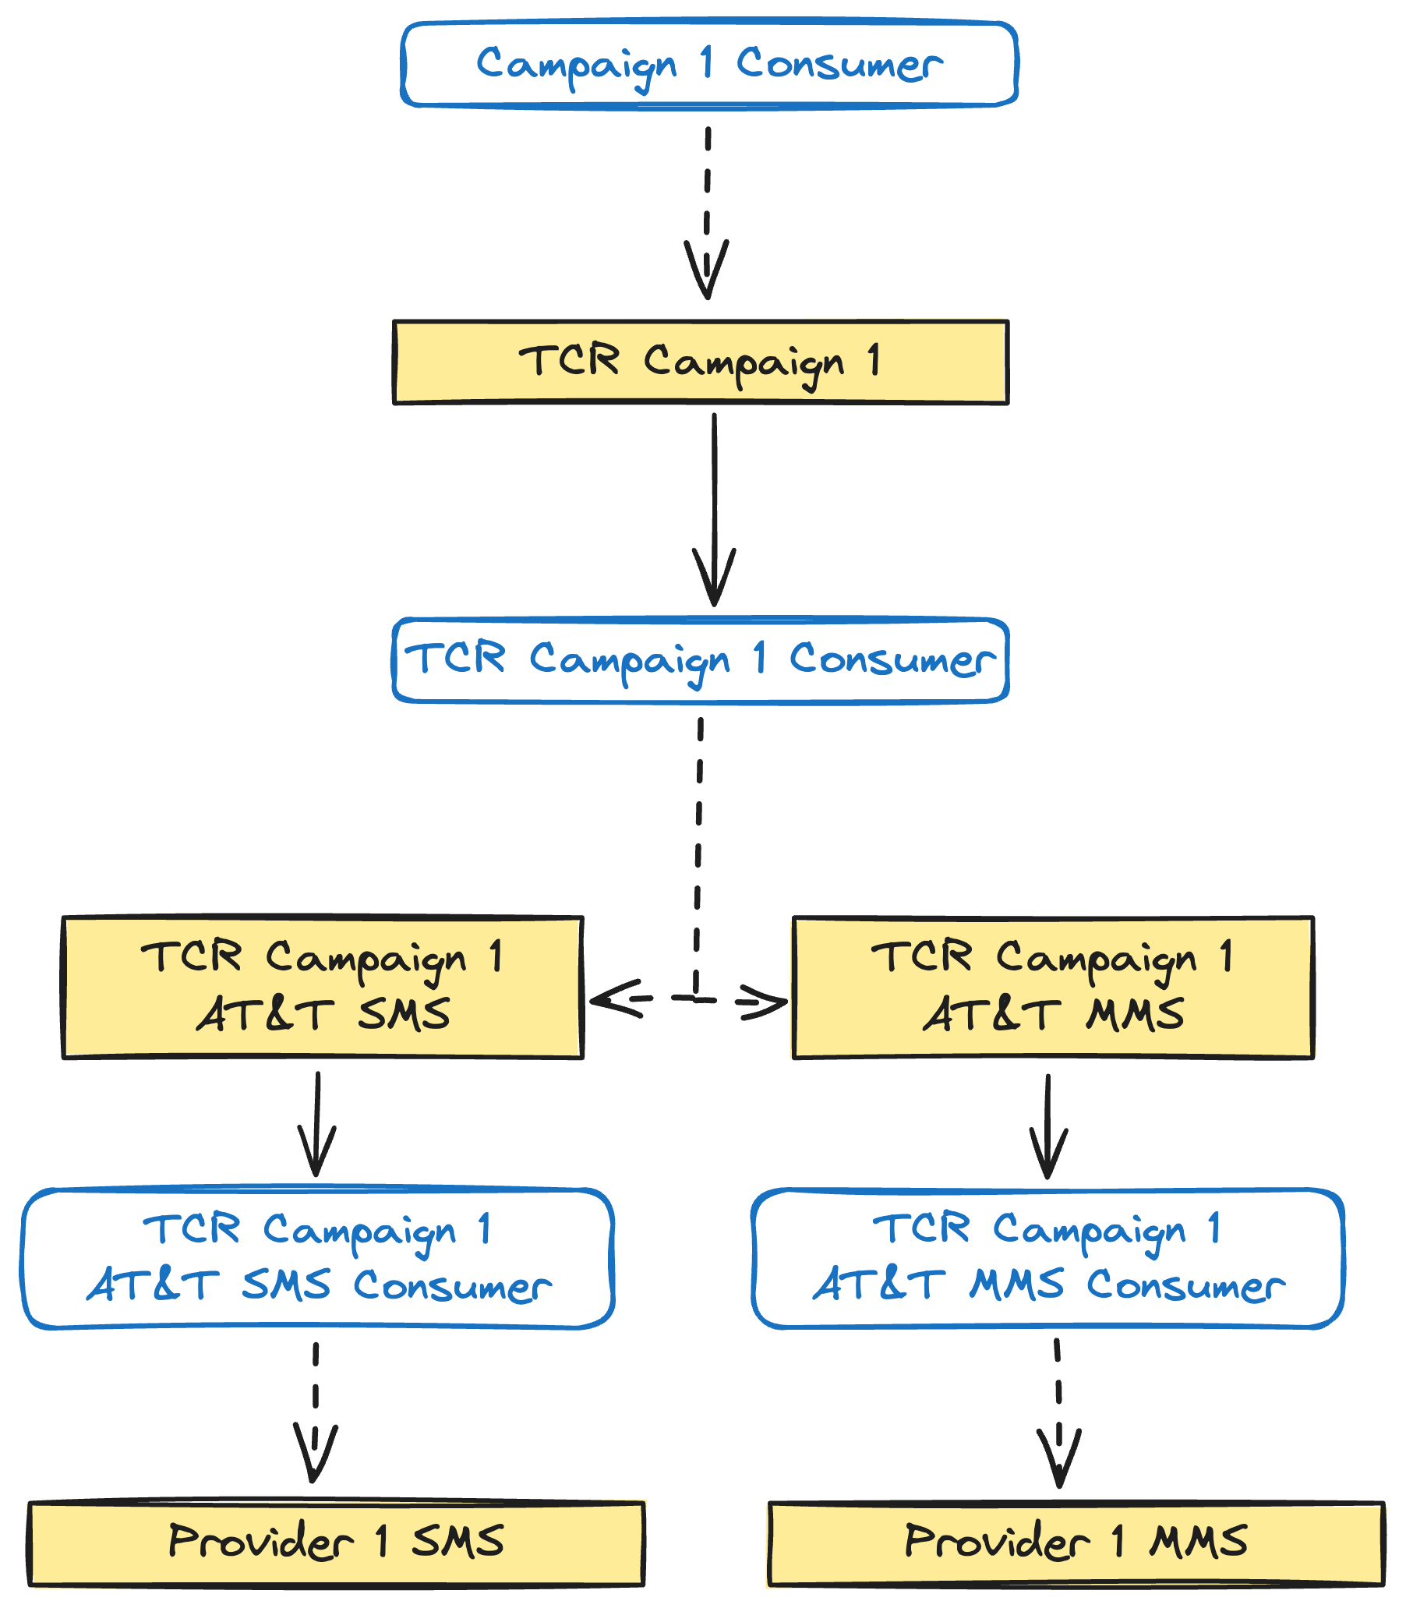
Notes:
We once against start with the campaign consumer, which determines the campaign is in the US. Then it gets passed to the TCR campaign queue. The consumer for that queue looks at the carrier the text message recipient is using and the type of message to forward it to the correct carrier queue for the campaign. For a SMS message to an AT&T phone number, we end up at the TCR Campaign 1 AT&T SMS queue.
The consumer for this queue pulls messages off while respecting the carrier rate limit we got from TCR. This is done once again using back pressure. If they say we can send 100 messages/minute, the consumer is going to have its rate limit set to 100 messages/minute. And that is all this consumer does. It exists to rate limit messages according the TCR rate limits we were given for that TCR campaign. It just forwards messages on to the correct provider queue.
Now, you might be asking what the point of the TCR campaign queue and consumer are. That’s a very good question.

Slide 52

Lesson Learned
Stages Are For Concurrency
and Back-Pressure
Notes:
They shouldn’t exist and we’re going to remove them. You should not add stages to your pipeline as a way of separating business logic or business concerns. They should only exist if you need to control concurrency and/or back-pressure separately for that stage.
The TCR campaign stage had been low key bothering me, but while preparing this talk I realized it had no reason to exist at all. This kind of separation is even called out as anti-pattern in the Broadway documentation.
But of course not every carrier can do everything the same way. What fun would that be?

Slide 53
T-Mobile Daily Caps
Notes:
Let’s talk about T-Mobile. T-Mobile has decided that their TCR caps are per day. No big deal, right? We can just use back-pressure with a really long window. No problem.
The issue is that deployments would bring down the app and reset the rate limit for the day. That’s not acceptable. We need that rate limit to be respected for the entire day no matter how many deployments we do or how many nodes come up or down in our system. It’s not a big deal if we have per minute or per second rate limit and the Broadway consumer gets restarted. In the next minute or second everything will be fine again. That doesn’t work when the rate limit window is an entire day.

Slide 54
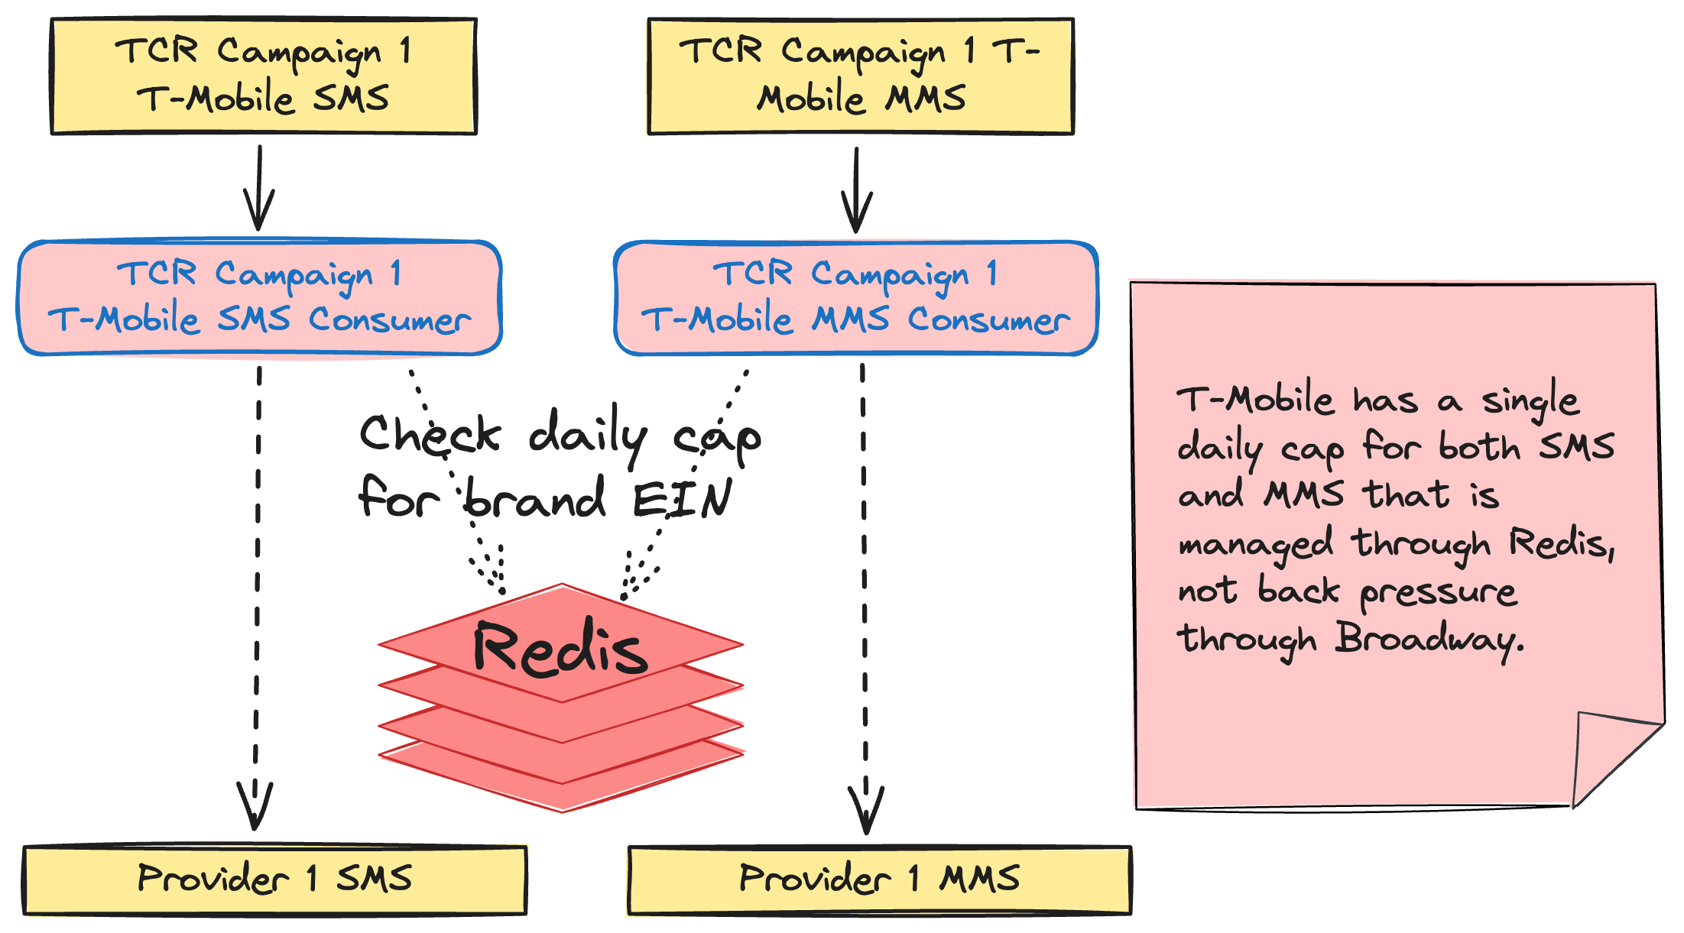
Notes:
This shows the TCR campaign queues and consumers for T-Mobile. Instead of using Broadway back-pressure, we instead rely on persistent counters in Redis. And T-Mobile has one more curveball for us too. They rate limit by the TCR campaign brand’s Employer Identification Number, the EIN. So, we keep track of how many messages have been sent for that brand EIN for the day in Redis. Every node in our cluster checks the same key in Redis for that brand's EIN.
If we haven’t hit the limit yet, the message can be forwarded to the correct provider queue. If we have hit the limit, then it needs to be sent to a retry queue. We talked about retry queues in the context of providers, but the same retry strategy applies to all of these carrier consumers as well.

Slide 55
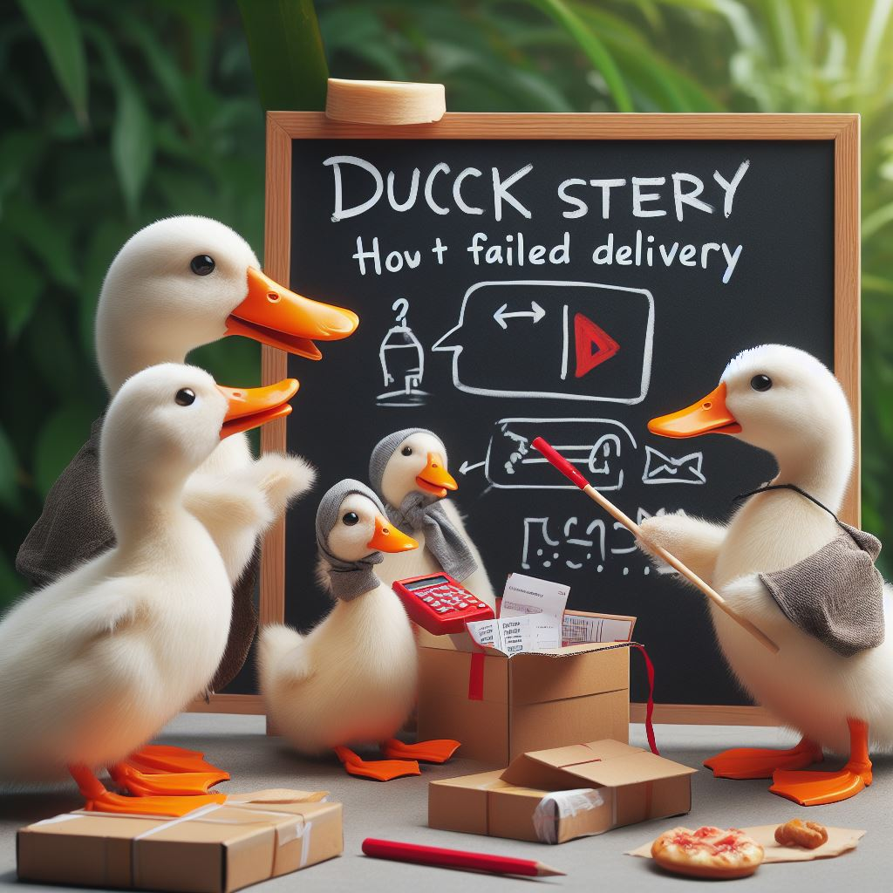
Lesson Learned
Different Retry Strategies
Notes:
And that brings us to another lesson learned. We’re pretty happy with our dynamic retry queue strategy, but it isn’t appropriate in all cases. T-Mobile is one of those. When we hit the daily cap for T-Mobile, we know exactly when we can retry that message again. It’s whenever the campaign opens the next day. But our strategy of exponential backoff with dynamic retry queues doesn’t know that. We end up retrying messages that we know with 100% confidence cannot be sent until the next day. This isn’t a huge deal, but is wasted work.
We haven’t fixed this yet, but we should be able to calculate the TTL of the message in the retry queue so that it expires when the message is eligible to be sent again. Since they’ll all be eligible again at the same time, they all end up expiring at the same time, avoiding the issue of messages expiring out of order that our dynamic retry strategy is designed to avoid.

Slide 56
Requirements
Lessen load on DB
Separation of concerns (rate limiting and business logic)
Respect all provider rate limits
Respect all TCR rate limits
Intelligent retries
Observability
Batch sending
Scheduled sending
Notes:
And now we’ve satisfied our requirement to respect all TCR rate limits as well.

Slide 57
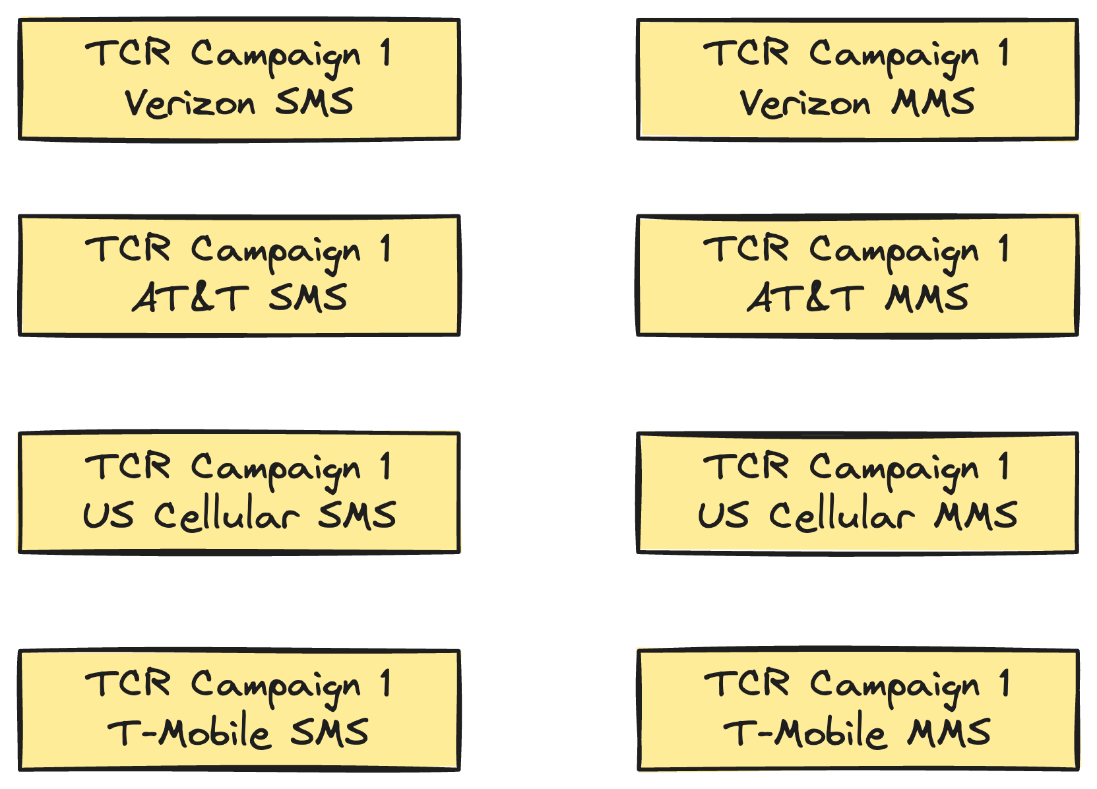
Notes:
This is potentially a lot of queues and consumers. For each TCR campaign, there are four carriers. Each carrier has separate SMS and MMS rate limits, they each get separate queues too. That brings us to 8 queues per TCR campaign.

Slide 58
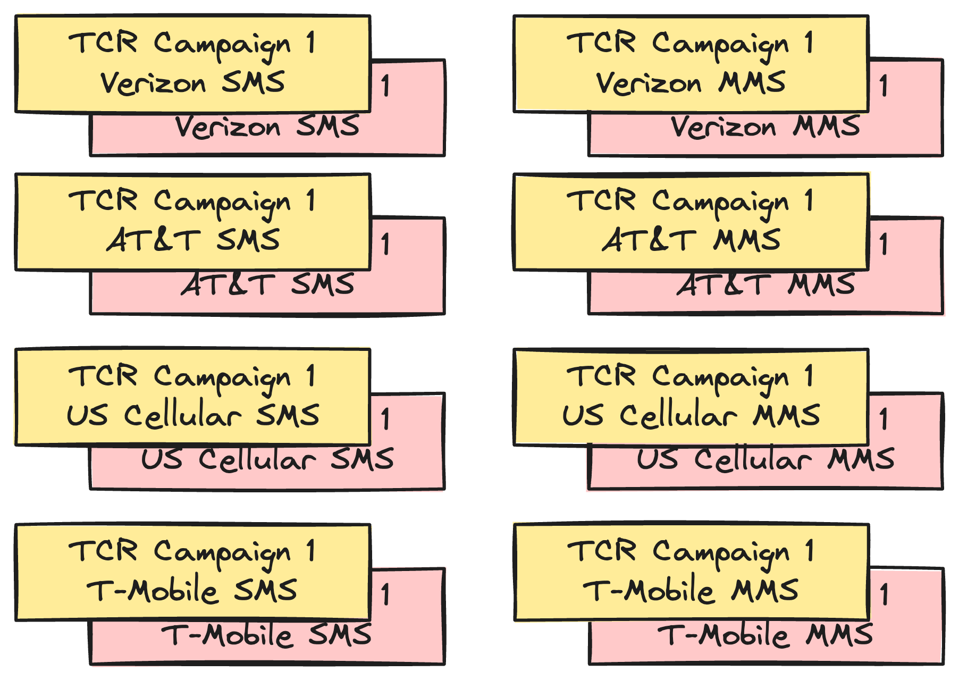
Notes:
But then that gets doubled because they all get their own dead letter queue as well. And then there are potentially even more because retry queues can be created dynamically.

Slide 59

Lesson Learned
Profile Resource Usage
Notes:
This brought up the question of resource usage. How much memory were are these queues and consumers going to use? We were reasonably confident that we were fine, but decided to do a bit of benchmarking just to be sure.
The good news is that we were right, but it’s still important that we checked. An empty Rabbit queue uses ~20KB of memory, so we weren’t paying a large penalty for having these empty queues sitting around. The same is true for Broadway consumers. Processes are cheap on the BEAM. Even though a Broadway consumer sets up supervision tree with multiple processes running underneath it, those processes don’t use much memory.
But don’t assume. Validate your assumptions.

Slide 60
Notes:
That is entire pipeline, from beginning to end. That’s not all we had to build though. The pipeline is the core of the Super Collider, but not all of it. There are other restrictions beyond rate limits that we need to worry about.

Slide 61
Campaign Sending Windows
Notes:
The main one is sending windows. Hopefully you’re not getting campaign text messages outside of legally allowed hours. If you are, then they aren’t coming from us. Regulation prohibits phone or text solicitation outside the hours of 8am – 9pm.
On top of that, our system has an additional restriction on when the initial message for a campaign can be sent. For example, a campaign may have a timely fundraising message for a university's giving day. The initial message will refer to the giving day being today. Any initial messages that are not sent out by the end of the day should not be sent.
The way we enforce this is by dynamically creating parts of our topology when a campaign opens and tearing it back down when a campaign closes for the day.

Slide 62
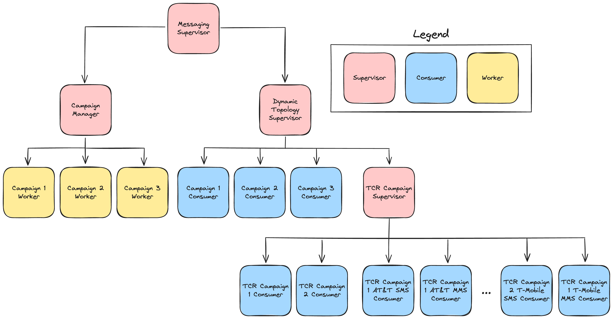
Notes:
We lean hard into what Elixir does best, small independent processes organized in a supervision tree. The bare minimum you need to understand is that Elixir applications can be thought of as a tree of processes. All non-leaf nodes are supervisors.
This is a simplified supervision tree for part of our application. When the application starts up, we create a campaign worker process for every active GetThru campaign in our system. Each campaign worker process is responsible for calling the dynamic topology supervisor when the campaign opens to create the GetThru campaign consumer and the TCR campaign consumer if one does not exist yet. The campaign worker process then schedules a message for itself when the campaign is scheduled to close.

Slide 63
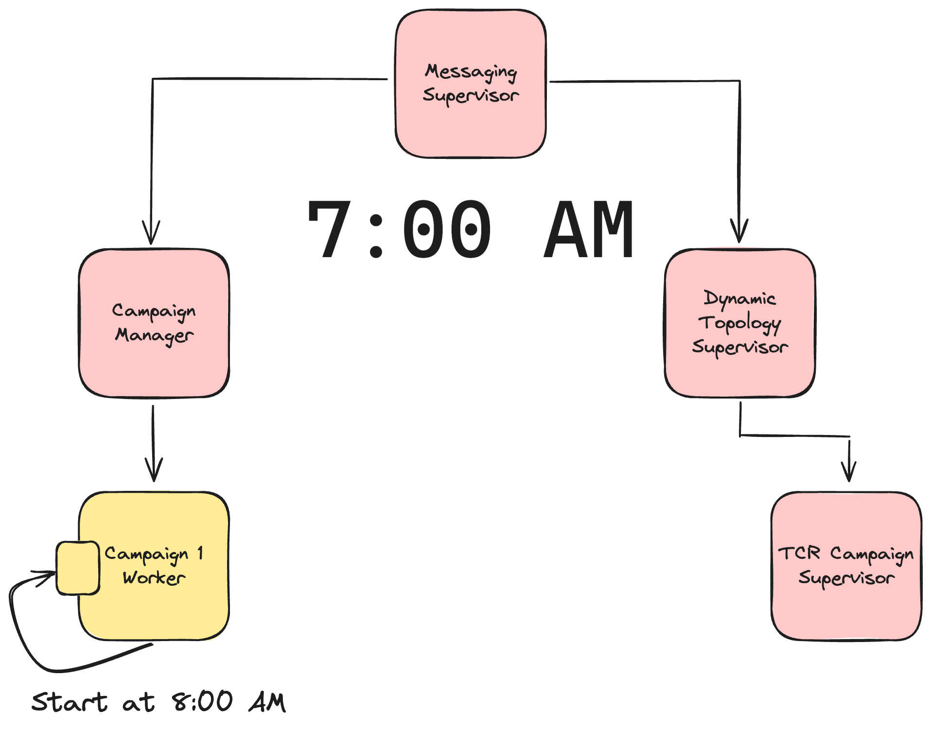
Notes:
Let’s look at a simplified example. Let’s stay we’ve started our application up at 7am and that campaign 1 is scheduled to start at 8am. No consumers have been started for this campaign yet, so no messages will be processed, even if they end up in the campaign’s queue. This is what we want. No messages should be able to go out until the campaign opens at 8 AM.
Campaign 1 schedules a message for itself at 8 AM to start the campaign.

Slide 64
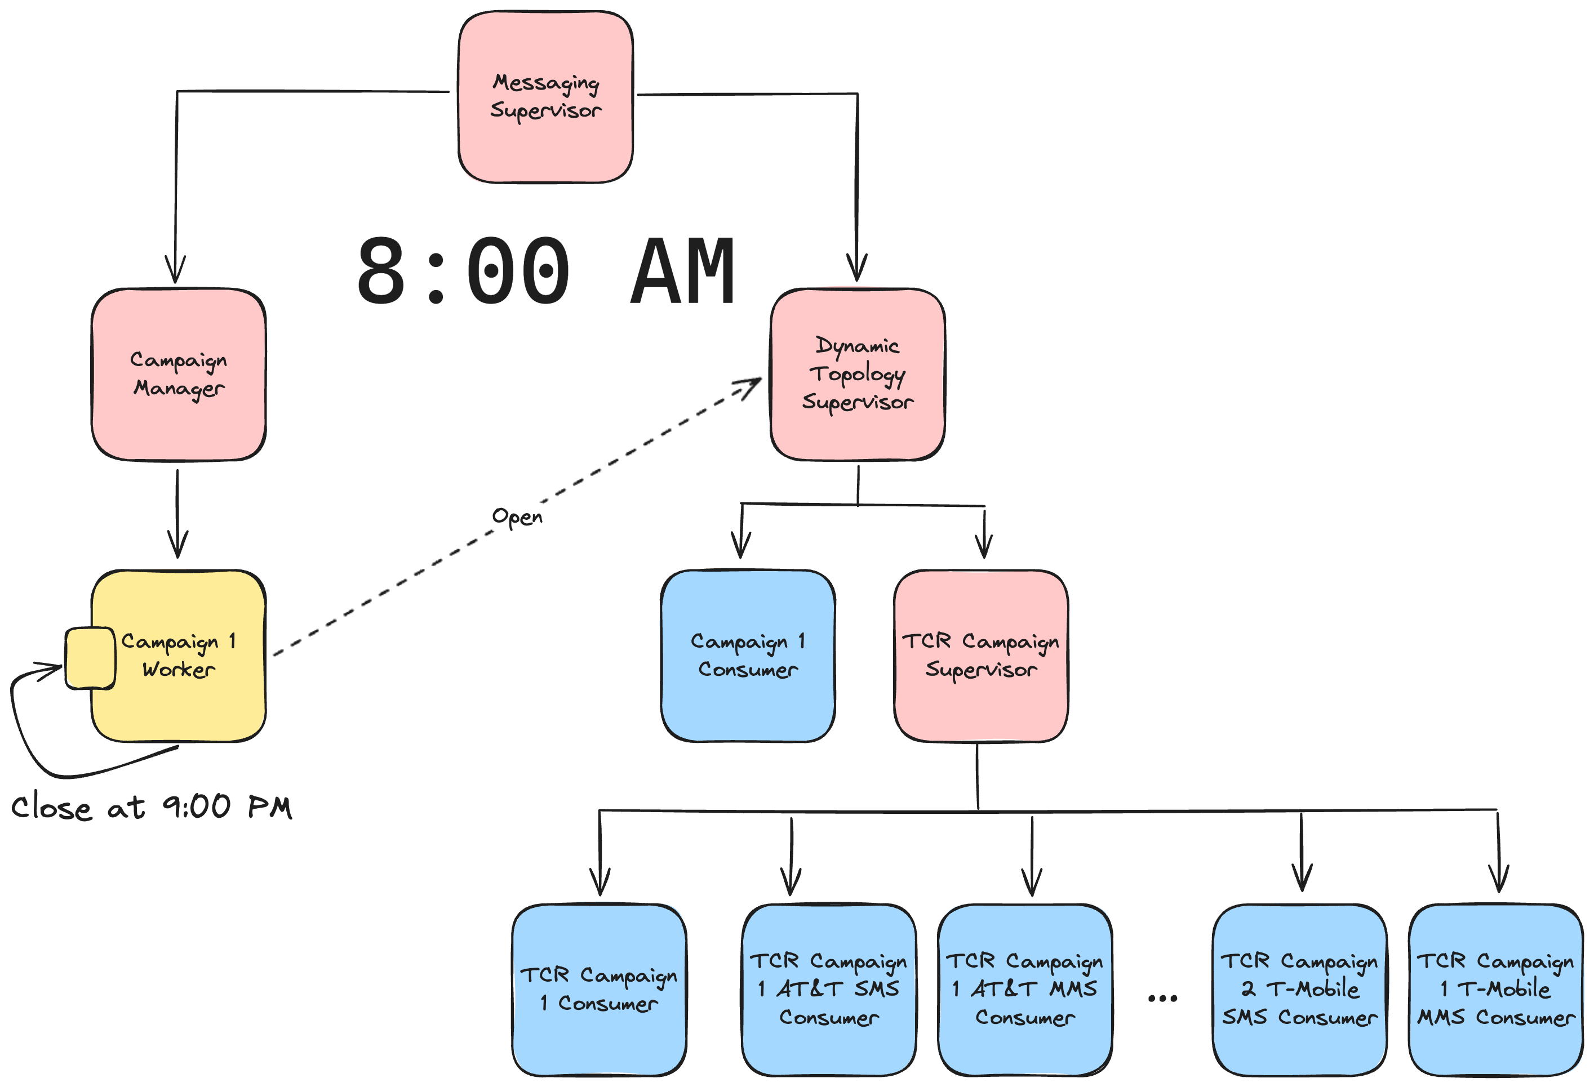
Notes:
8 AM roles around and the message gets delivered to the campaign worker process. This starts all the consumers for the campaign. The GetThru campaign consumer has beens started. The TCR campaign consumer has been started, and all the TCR campaign carrier consumers have been started as well. Once those are started, the campaign worker schedules another messages for itself. This time it’s for 9 PM when the campaign is scheduled to close.

Slide 65

Notes:
9 PM roles around. The close message is delivered to the campaign worker and it shuts down all the consumers. Then it schedules another message for itself to start everything back up at 8 AM the next day.

Slide 66
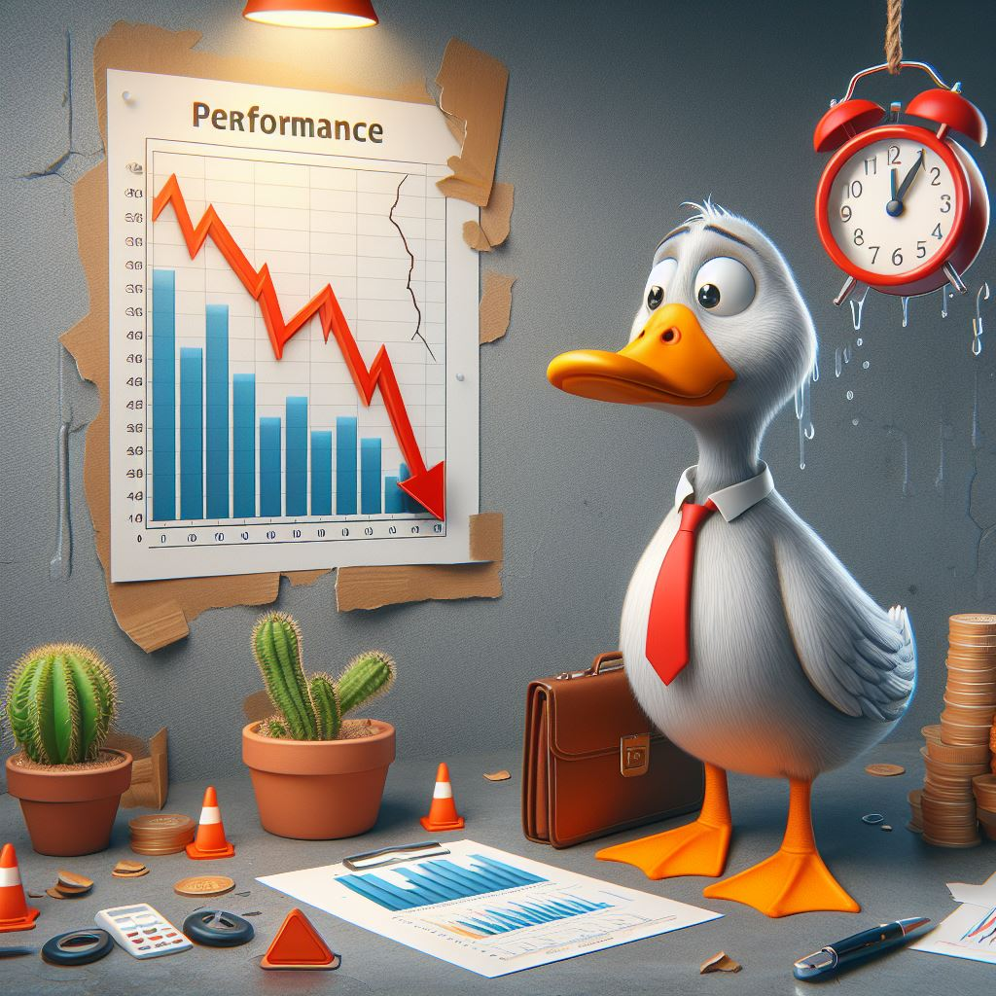
Lesson Learned
Do Not Be Too Dynamic
Notes:
An earlier iteration of the campaign worker processes tried to be even more dynamic and not start up the consumers until they were actually needed. For example, if the campaign opened at 8 AM, but no messages were sent until 8:30 AM, the consumers would be started at 8:30 when the first message was sent.
We did this by having each campaign worker process poll. We had some bugs though that caused a severe performance regression in prod on other parts of the system. We were being more dynamic when we needed to be. Moving to our current system of only scheduling messages for open and closed times made the system easier to understand and less bug prone. Elixir processes are cheap. We over engineered part of our system and paid a price for it in prod.

Slide 67

Clustering
Notes:
We've talked about a lot about rate limits, but we’ve been ignoring an important caveat. Our app runs in a cluster with multiple nodes. Each node is going to have consumers taking messages from each queue, but the queues and rate limits are global. For example, every node in our cluster is going to have a consumer to send SMS messages to provider 1. All of those consumers are pulling from the same queue in Rabbit and must respect the provider rate limit in the aggregate.

Slide 68
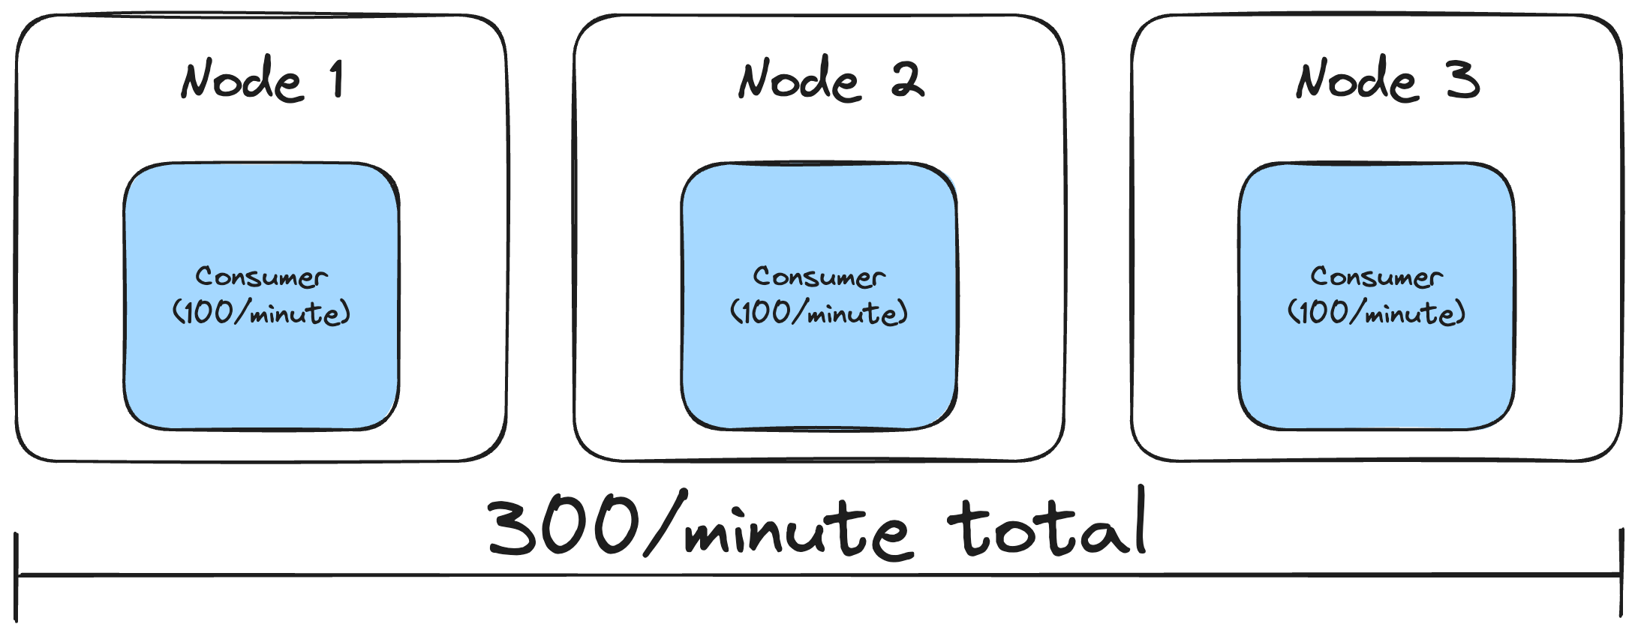
Notes:
This means that if we have a rate limit of 300 messages/minute and we have 3 nodes in our cluster, then each consumer should be rate limited to 100 messages/minute. Overall, we’ll still be respecting the provider’s rate limit of 300 message/minute and the load is spread evenly across our nodes.

Slide 69

Dynamic Rate Limit Changes
Notes:
But what happens when our cluster resizes? Luckily, the BEAM VM that Elixir runs on has us covered again. We can subscribe to events letting us know that that a node has joined or left the cluster. We have a rate limit monitor process on each node that subscribes to these events. We can update the rate limits on the Broadway consumers at runtime.
Another way this can happen is if TCR changes the score for a TCR campaign. They’ll notify us of the updated rate limits in a webhook and we can update the rate limits as needed on Broadway consumers.

Slide 70

Notes:
One of our requirements was observability. We've tackled this from a couple of different directions.
First, we're using OpenTelemetry to track a lot of information. We have a lot of traces tracking messages through the system. We also track various metrics around retries, failures, and successfully sent messages. This gives us a high level view of how the system is behaving.

Slide 71

Campaign Dashboard
Notes:
Beyond that, we've been building an internal campaign dashboard for staff members to track the health of campaigns. If issues come up, we can see that a campaign is unhealthy and pause it while we triage the issue. This will tear down all the consumers, just like if the campaign had passed its sending window for the day.
This dashboard also lets us see all the rate limits being applies to a campaign at a glance.
We also segment our customers by tiers. This dashboard lets us easily turn the Super Collider on or off for various tiers of customers. This was needed because our feature flag library doesn't have support for side effects when a feature flag is toggled.
This dashboard has a lot potential, but is pretty immature right now. We haven't hit the pain points that we'll inevitably hit. Once we hit those, we'll have a better idea of what data to surface here and what control points we need to manipulate the system at runtime.

Slide 72
Requirements
Respect all TCR rate limits
Respect all provider rate limits
Separation of concerns (rate limiting and business logic)
Intelligent retries
Lessen load on DB
Observability
Batch sending
Scheduled sending
Notes:
I’m going to check off observability here, but we know that we have a ways to go here. The bones are solid, but we need more experience with the system to know what gaps to fill.
We did small testing throughout the buildup to release, but as we were getting closer, it was decided that a more thorough QA plan was needed. It was time to put the Super Collider through it’s paces.

Slide 73
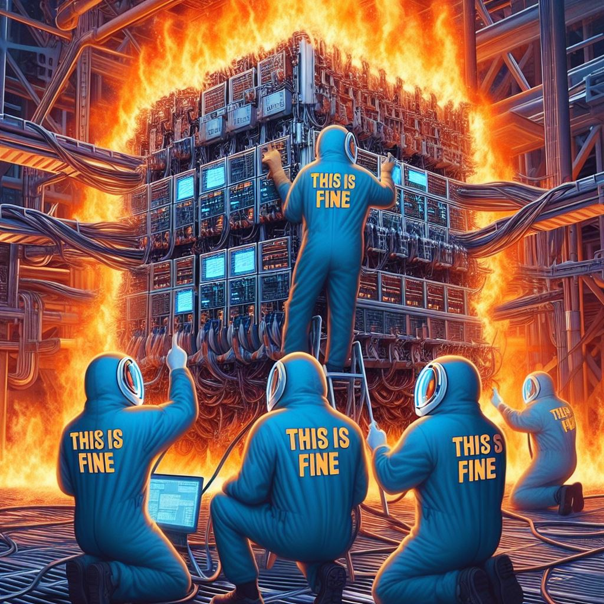
QA
Notes:
It did not go well.

Slide 74

Supercollider Repairs
Notes:
What happened? What did we miss? Beyond the normal bugs when implementing a new system, there were a couple of large issues that needed addressed.

Slide 75

UI Issues
Notes:
The first was UI related. We were seeing a number of oddities in the behavior of our UI while developing our pipeline. We kept putting them off though. We thought that they certainly couldn't be a big deal. I mean, the pipeline was completely decoupled from the UI, right? There was no way these UI issues were caused by our new messaging pipeline. Certainly not...
We were wrong. Very wrong.The existing message sending UI didn't handle the new pipeline well. It made a lot of implicit assumptions about latency of data being inserted into the DB that the Super Collider broke.
In addition, the messenger live views are by far the most complicated UI in our app and had accumulated the most tech debt. It reached the point that updating the existing messenger live views wasn't worth it. Our legacy system needed to continue to work while we rolled out the Super Collider. The pain of continuing to support two separate message sending strategies with one UI just wasn't worth it.
We declared tech debt bankruptcy and forked our messenger to a new version that only worked with the Super Collider. What we had thought would just be some quick bug fixes, and then thought would be just some changes that broke backwards compatibility with the old messaging system, ended up turning into a full rewrite of the core logic of these UIs

Slide 76

Lesson Learned
Unexpected Coupling
Notes:
In the long term, this is a good thing. We were able to drastically reduce the DB load that these views had. We used to hit the DB constantly to load new data. Now we optimistically update the UI when sending a message. When a message finally is sent through the Supercollider, we communicate back to the UI through PubSub to confirm that the message was actually sent. We do all of this with very little traffic to our DB. We ended up in a better place, but it was pain that we did not plan for.
In the short term, it was disastrous. It significantly delayed our launch. Don’t assume that parts of your system are decoupled. Pay attention to those bugs that are creeping in that you can’t explain. They may be pointing to a deeper issue

Slide 77

Segment Rate Limits
Notes:
We ran into one other large issue.
This entire talk I've been talking about rate limiting by message, but that has been a little white lie. SMS messages are comprised of segments. When a message gets to a certain length, the message is split into multiple segments. Well… it turns out that our SMS rate limits for carriers and providers are by segment, not message.
In our defense, a lot of the documentation from TCR and our providers is unclear about this. But it doesn't matter how we got here. Either way our rate limiting was wrong.
We thought about hacking around this by looking at the average segments on a message. That would stem the bleeding until we could get a real fix. Unfortunately, the number of segments varies a lot. We were going to exceed our rate limits too often to be comfortable.
What we really wanted was a weight on a message so we can say how much it counts toward the rate limit. If a message is 3 segments, we want it to count as 3 towards the rate limit. Then we can continue to rate limit through back pressure.
Unfortunately, this is not supported out of the box with Broadway. Fortunately, Broadway is open source, so we were able to fork it internally to add weight to messages. For now, we’re maintaining this fork ourselves, but we’re hoping to get it upstreamed back into Broadway. The main issue there is going to be philosophical. Does the Broadway team think message weights should be a feature or not? There are some weird corner cases that rate limiting by message weight introduces. We haven’t had those conversations with the Broadway team yet.

Slide 78

Lesson Learned
Understand Your Domain
Notes:
That brings us to one of the roughest lessons we learned: understand your domain. We did not ask enough questions to understand earlier that so many of our rate limits were actually by segment and not message. This was wrong in our current/old system and we didn't question it.
I think we would have ended up in a similar place of adding weights to messages in Broadway, but this is the kind of high risk work that should have been identified sooner so we could front load the risk to the beginning of the project, not the end. This was a significant technical risk for us and we flat out missed it.
So, be sure to poke and prod at your domain from different angles. Be ridiculous and play devil's advocate. Consider doing pre-mortems on a project. Ask what would happen if X failed or Y was true. You may come up with scenarios you don't care about, but at least you're consciously setting them aside instead of being surprised later.

Slide 79

We Haven’t Shipped
Notes:
Now we come to the moment of truth. We’ve fixed these issues. We rewrote the live views for our messenger UI. We forked Broadway so we can correctly rate limit by segment instead of message.
I submitted this talk to StirTrek in late January. At the time we were early in testing to start rolling out to production. This was right before the depth of our UI issues came to light.
Has anybody ever thought a project was almost ready to launch and then learned there a bunch more work to do? That the first 80% was done and now only the second 80% remained. That was us and that is why we haven’t shipped.
But we’re shipping very soon. Hopefully for real this time! And that is why I can’t stand before you today with lots of pretty charts showing our performance in production between the two systems. For that I apologize. I’m sure just about everybody in this room has been in a similar position, just maybe not standing in front of an audience having to admit it publicly.

Slide 80
What We Liked
ADR process
Documentation with ex_doc
Rate limiting in Broadway
RabbitMQ
Improved UI performance
Notes:
Writing an ADR was a great early step. It was a touch point for the team to agree on what was being built and the high level architecture. I joined the team after the project was started and being able to refer to the ADR was helpful in getting up to speed.
It wasn't a panacea though. For example, we missed on the segment rate limiting. Ideally, we would have caught that in the ADR process.
ex_doc is the documentation system in Elixir and it has been fantastic for us on this project. It generates very nice documentation from Markdown that lives right next to your code. We were able to generate documentation at multiple levels of understanding. Embedding Mermaid diagrams right in our docs was great too.
The way we were able to easily rate limit messages in Broadway with back pressure was great. This was way better than our previous system of constantly retrying messages. It wasn’t ideal that we had to fork Broadway to add weights to messages, but even that was easier than we expected.
Because we're an Elixir shop and RabbitMQ is written in Erlang, debugging issues with it is not anywhere near as intimidating as it might be for other shops. The lesson learned here is to use tools that you're already comfortable with. Don't introduce new infrastructure that you don't need.
Because we were doing less work up front and bulk inserting as the first stage in the pipeline, the UI became more responsive. A downside of this is that doing less work up front broke a lot of expectations that UI was making. We ended up having to rewrite the core logic of those screens, which were the most complex part of our app. That led to even more UI performance improvements though.

Slide 81
Future Improvements
Batch and scheduled sending
Daily caps and retry strategies
Separate queues and consumers for 3rd party integrations
Clean up tech debt
Improved automated tests
Load testing
Improved caching
Improved observability
Linked traces
Event sourcing with RabbitMQ streams
Notes:
Future improvements, beyond, you know, actually shipping.
We haven’t implemented batch and scheduled sends yet, but with our current architecture it should be straightforward to implement.
We use the same retry strategy for all rate limits, but we would benefit from a different strategy for daily caps. There is no point in continuing to retry a message until the next day if the daily cap has been hit.
We currently use one queue and consumer for all 3rd party side effect integrations. It would be nice to split these out at some point.
We currently have two systems for sending messages. We're looking forward to fully removing the old system once we're fully over to the Super Collider. That will simplify large parts of our system.
We struggled to write comprehensive automated tests for parts of the system due to the dependency on RabbitMQ. We would benefit a lot from starting to look at system level tests of various scenarios.
End-to-end load testing is currently very expensive because we send out actual text messages. We have the beginnings of our own internal mock provider. Building this out more is really necessary if we want to do repeatable load testing without breaking the bank.
The bulk inserts and updates helped a lot with DB performance, but there are places scattered throughout the pipeline where we still read from the DB. We want to convert most/all of these to use caches instead.
We have a basic start on observability, but we need to bang on it more in production. The goal is to have it hardened and very observable by the November election.
We're using OpenTelemetry, but the service we send our traces to only recently added support for linked traces. This would allow us to link together all the traces for a message as it flows through our pipeline. We can trace this through logs to a certain extent now, but being able to do so through linked traces would be nicer.
And finally, this last one is pretty speculative. If we used RabbitMQ streams, we could have a stream per campaign in addition to the queue, Then we could expose that stream on our internal campaign dashboard. If we publish a message to the stream whenever a message gets moved through our pipeline, we end up with an audit trail of how a message moved through the system. The dashboard could show the full history, a slice of time, or just tail what is currently happening.

Slide 82

Website
https://brianmeeker.me
Mastodon
@brianmeeker@hachyderm.io
Any questions?
https://github.com/CuriousCurmudgeon/broadway_case_study
Notes:
Overall, we're pretty happy with what we've built. We recognize there is a lot of polish to be done over time, but we're confident that we have a system that can stand up under the load of an election season.
I wish I was standing here with a system in production and hard data to show you, but, unfortunately, things didn't work out that way.
Many thanks to everybody I work with at GetThru. I'm the one up here talking, but everybody on our team worked on this project in various ways. If you have any questions, come on up and chat or find me later. You can also track down my co-worker, Matt. He is probably more responsible for this system than anybody else at GetThru.
The slides will be available on GitHub and you can find me on Mastodon or in the Stir Trek Discord if you have questions after the conference as well. Thank you and enjoy the rest of your day.

